Slide 1
District 1060 Rotary Foundation
Foundation Seminar
Peter Ramage
District Rotary Foundation Chairman 2019-22

Slide 2
Seminar Agenda
Introduction to Contributions and Funding including Polio
Questions and Answers
District Grants
Q & A
Global Grants
Q & A
Disaster Response Grant
Q & A and closure

Slide 3


Which comes first? Funding or Project

Slide 4

A tale of four funds
Annual
Fund
Donations
Permanent
Fund
Polio
Fund
Disaster Response Fund
Notes:
The Annual Fund is the ‘default’ when someone donates to The Rotary Foundation. It is the core project fund that will be used in three year’s time to provide the District with its new District Designated Fund (DDF) allocation.
The Permanent Fund usually receives donations from legacy (contributions from wills). It is not spent, with the income from the fund being added to the Annual Fund donations to boost the new DDF allocation.
The Polio Fund is specific to the Polio Eradication work.
The Disaster Relief Fund is new and is explained on the next slide.
4

Slide 5
Polio Eradication
Are we really “Almost There”
Update on Current situation
Covid-19 problems
Your help and contributions are still required
Order your Purple Crocus Corms now closing date 31st August but limited supply and prices could go up. See RIBI Newsletter or contact me
Order your Cloth Crocus Lapel Badges, box of 100

Slide 6
A tale of four funds
Annual
Fund
Donations
Permanent
Fund
Polio
Fund
Disaster Response Fund
Notes:
The Annual Fund is the ‘default’ when someone donates to The Rotary Foundation. It is the core project fund that will be used in three year’s time to provide the District with its new District Designated Fund (DDF) allocation.
The Permanent Fund usually receives donations from legacy (contributions from wills). It is not spent, with the income from the fund being added to the Annual Fund donations to boost the new DDF allocation.
The Polio Fund is specific to the Polio Eradication work.
The Disaster Relief Fund is new and is explained on the next slide.
6

Slide 7
Global / Local Projects
World
Fund
50% of Every District’s
Annual Fund
District
Designated
Fund
Per District
(DDF)
Notes:
The Project Funding is split into two. Half from every District makes up the World Fund, with the other half being returned to the control of the District as the new District Designated Fund (DDF).
7

Slide 8
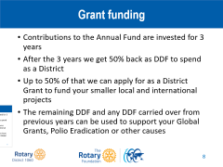
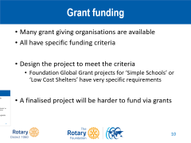
Grant funding
Contributions to the Annual Fund are invested for 3 years
After the 3 years we get 50% back as DDF to spend as a District
Up to 50% of that we can apply for as a District Grant to fund your smaller local and international projects
The remaining DDF and any DDF carried over from previous years can be used to support your Global Grants, Polio Eradication or other causes

Slide 9
Grant funding
2017-8 2018-9 2019-20
Contributions 58973 59907 62818
Polio 31725 22433 32390
Average per member 39.08 43.66 47.30
DDF 29486 29953 31409
District Grants
2019-20 (+10000) 29505 = £23,899
2020-21 (+10000) 24743 = £20,000 approx
2021-22 14976 = £12,400 approx

Slide 10

Increase Contributions
How can we encourage increased contributions to get us higher up the table for giving
Get members to make some donations including gift aid through RF UK. Encourage some members to become a sustaining member
Many members during lockdown will have saved money on holidays, travelling, meal costs, drink costs etc.
Support your local charities but also remember the Rotary Foundation which is our charity

Slide 11
Questions?

Slide 12
District Grants

Slide 13
Rotary Foundation Criteria
Meet the Foundation mission statement
“To enable Rotarians to advance world understanding, goodwill, and peace through the improvement of health, the support of education, and the alleviation of poverty”
More simply “Doing Good in the World”
Specifically, there are Grant Terms & Conditions that are well documented, but are updated from time to time

Slide 14
District Grant Criteria
Small projects
  Maximum £1,000 funding per Club per project (per year)
  Can support local or international projects
  Club has to put in >=50% of project cost
  Has to have Rotarian involvement and / or a publicity opportunity
  Multiple Clubs can pool grant funding
One option is to ‘buy something’ to present
  A unit cost allows the request to be ‘scaled’
  Estimate / Quote with application
  Receipts with report

Slide 15
Grant funding
2017-8 2018-9 2019-20
Contributions 58973 59907 62818
Polio 31725 22433 32390
Average per member 39.08 43.66 47.30
DDF 29486 29953 31409
District Grants
2019-20 (+10000) 29505 = £23,899
2020-21 (+10000) 24743 = £20,000 approx
2021-22 14976 = £12,400 approx

Slide 16
District ‘matching’
Club(s)
Cash contributions from one or more Clubs
District
District Grant contribution
Equal match up to £1000
(2021-22 will be less)

Slide 17
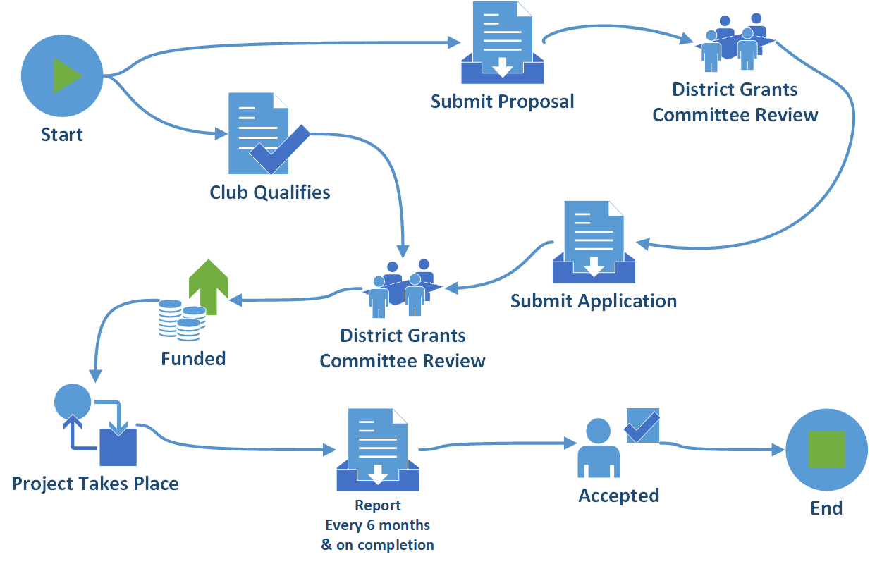
Process
Notes:
17

Slide 18
Recommendation
If you have a suitable project idea for a District Grant project
Ideally with no time constraints
Submit it at any time for consideration when funds become available

Slide 19
Questions?

Slide 20
Global Grants

Slide 21

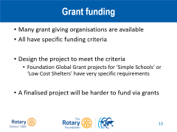
Grant funding
Many grant giving organisations are available
All have specific funding criteria
Be aware of what the restrictions are and what is required to apply
Design the project to meet the criteria
A finalised project will be harder to fund via grants

Slide 22
Global Grant Criteria
Large projects
  Minimum $30,000 project budget
Meet a community need
  Formal needs assessment required
Partner with Club(s) in another country
  >30% of the funding from outside the ‘project country’ (with the exception of Scholarships)
Meet one or more Areas of Focus
  A primary Area of Focus is strongly advised

Slide 23






Areas of Focus
 | Peace and conflict prevention/resolution
 | Disease prevention and treatment
 | Water and sanitation
 | Maternal and child health
 | Basic education and literacy
 | Economic and community development
 | Environment (from 1st 2021)
?

Slide 24
Global Grant Criteria
Project needs to be sustainable and meet Rotary requirements and conditions
Application is made on-line by all parties but there are various trial versions available that you can use to try out various funding methods
Clubs again need to be Qualified and have signed the MOU
Records need to be kept, reports need to be completed
Support for Global Grants supported from other Districts will be matched 50% from District

Slide 25
Two stage ‘matching’
Club(s)
Cash contributions from one or more Clubs
District(s)
District Designated Fund contribution
(determined by each District Foundation Committee)
World Fund
100% match for DDF contribution

Slide 26
World Fund Matching
+ 100%
DDF(C+D) Contribution
Project Budget
World Fund
A
C
B
D

Slide 27
Matching – Figures for 70/30 split
So a group of Clubs can run a £24,300 project after raising £8,100
(simply a third of the overall total)

Slide 28
Global Grant Funding Example
Project Budget
World
Fund
Club
DDF

Slide 29
Global Grant Funding Example
Project Budget
World
Fund
DDF

Slide 30
Further information
Rotary.org for Rotary Club Central reports and the Grants Center.
Training session in the Learning center under “Grant Training Seminar”
Updates via Newsletters and on http://foundation.rotary1060.org.uk
Presentations on YouTube by Paul Beedham covering various Foundation topics
Consider donating to Foundation to make funding available for future projects
  Please don’t leave it to the end of the year ☺

Slide 31
Questions?

Slide 32
Disaster Response Grant

Slide 33
Disaster Response Grant
Covid-19 was designated as an International Disaster and was accepted as an acceptable cause to apply for a Disaster Response Grant to alleviate suffering
District applied for a Disaster Response Grant for $25,000 which is very roughly £20,000 for the support of local Foodbanks within the District
District has been awarded the Grant but not yet received

Slide 34
Disaster Response Grant
The Grant will be administered by the District Grants Sub-Committee and Clubs will be able to apply for a share of this Grant
Just like a District Grant the Club can apply for up to £1000 provided they put in an equal or greater amount to support your local foodbank
The awards will be made on a first come basis but there will be a time limit since we want to distribute this fairly quickly and share it around the Clubs in District

Slide 35
Questions?

Slide 36
District 1060 Rotary Foundation
Foundation Seminar
DG Tim Bushell

