Slide 1
Our Rotary Foundation
Standard Slides – 25th March 2021
Paul Beedham
District Rotary Foundation Chairman 2016-19
Peter Ramage
District Rotary Foundation Chairman 2019-22

Slide 2

Doing Good in the World
2

Slide 3






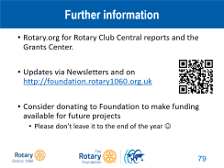


Contents

Slide 4
Setting the scene
4

Slide 5
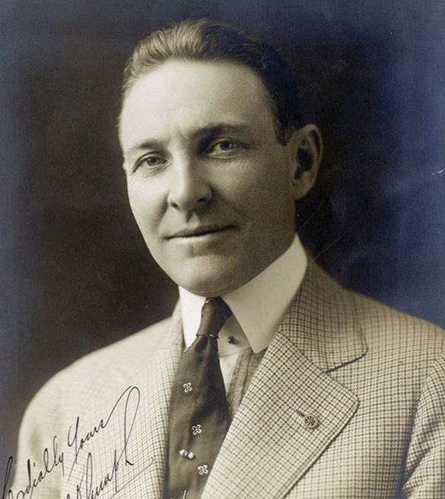
How did it all start?
1917
  Rotary International President Arch Klumph proposes an endowment for doing good
1928
  Formally named The Rotary Foundation
1947
  Paul Harris dies and Rotary sends out a telegram passing on his desire for donations to the Foundation in lieu of flowers…

Slide 6


Contribution History ($27.50 – Millions)
250
^{millions of dollars}
200
150
100
50
0
1917
1949-50
1954-55
1959-60
1964-65
1969-70
1974-75
1979-80
1984-85
1989-90
1994-95
2004-05
2009-10
2014-15
1948-49
1999-2000
6

Slide 7
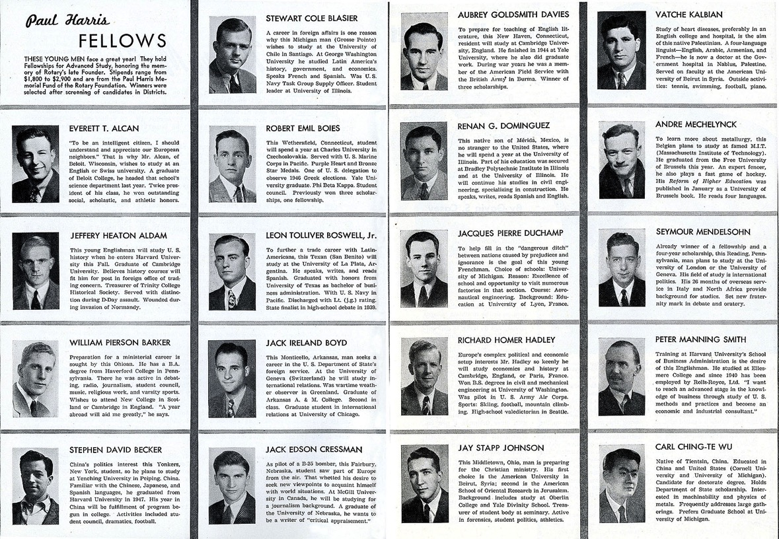
First Programme – Scholarships
7

Slide 8
The Mission
Original objective
  “Doing Good in the World”
Mission statement
  “To enable Rotarians to advance world understanding, goodwill, and peace through the improvement of health, the support of education, and the alleviation of poverty”
8

Slide 9
How it works
9

Slide 10

A tale of four funds
Annual
Fund
Donations
Permanent
Fund
Polio
Fund
Disaster Response Fund
10
Notes:
The Annual Fund is the ‘default’ when someone donates to The Rotary Foundation. It is the core project fund that will be used in three year’s time to provide the District with its new District Designated Fund (DDF) allocation.
The Permanent Fund usually receives donations from legacy (contributions from wills). It is not spent, with the income from the fund being added to the Annual Fund donations to boost the new DDF allocation.
The Polio Fund is specific to the Polio Eradication work.
The Disaster Relief Fund is new and is explained on the next slide.
10

Slide 11
Disaster Response Grants
“Districts that have been affected by a disaster can use Rotary disaster response grants to launch their own projects or work with established relief organizations to help their communities recover. Districts should work closely with local officials and groups to ensure that the funding will meet a specific community need.”
Maximum of $25,000
Can also use Global Grants & District Grants
Contributions made directly to the Disaster Response Fund
11

Slide 12

Three year investment
2017-18
Annual
Fund
2020-21
Project
Funding
Permanent
Fund
Spendable Earnings
12
Notes:
The donations made to the Annual Fund in 2017-18 are invested for three years, with the return on investment being used to cover the costs of running The Rotary Foundation. Those donations then create the Project Funding for the Rotary year 2020-21.
The earnings from the Permanent Fund add to that available Project Funding.
12

Slide 13
Global / Local Projects
World
Fund
45% of Every District’s
Annual Fund
5% -> Operating Expenses
District
Designated
Fund
50% Back to the District
13
Notes:
The Project Funding is split into two. Half from every District makes up the World Fund, with the other half being returned to the control of the District as the new District Designated Fund (DDF).
13

Slide 14
Balanced Global Funding
2017-18 Average Donations per Rotarian
  Globally = $113 (£87)
  District 1060 = $39 (£30 with £9 within subs)
We contributed less than half the average, but still have access to the same World Fund
14

Slide 15
District Designated Fund – 2020-21
50% of
contributions
3 years prior
£23,936
Rollover and
Transfers
DDF
Up to 50%
£8,520
District
Grants
Global
Grants
PolioPlus
Donations
Unused DDF
rolls over to
next year
£10,468
Disaster
Response
Fund
Rotary Peace
Centres
Donations
£17,568
£51,120
to Polio
15
Notes:
15
DDF rolls from one year to the next, with 50% of the donations made three years ago to the Annual Fund (plus the earnings from the Permanent Fund) being added in at the start of each year.
Up to 50% of the new DDF can be spent on a District Grant, with the rest available to boost Global Grant funding, or donate directly to Polio, Peace Centres, the Disaster Response Fund or to another District.
The beauty of the DDF donation to Polio is that it is matched first by the World Fund and then twice by the Gates Foundation – significantly magnifying the value.
For District 1060 - New DDF for 2019-20 = $38,900.88 (£29,923.75)
District Grant Max = $19,450.44 (£14,961.88) plus bonus $29,450 (£22,654)
Polio (20%) = $7,780.18 (rounded to $7,800) (becomes $15,600 after World Fund match of 100% and $46,800 after Gates Foundation match of 200%) or £36,000
Rolling total = $105,691.19 (£81,931.16)

Slide 16
District Designated Fund – 2021-22
50% of
contributions
3 years prior
£21,266
Rollover and
Transfers
DDF
Up to 50%
£4,253
District
Grants
Global
Grants
PolioPlus
Donations
Unused DDF
rolls over to
next year
£10,633
Disaster
Response
Fund
Rotary Peace
Centres
Donations
£19,140
to Polio
16
Notes:
16
DDF rolls from one year to the next, with 50% of the donations made three years ago to the Annual Fund (plus the earnings from the Permanent Fund) being added in at the start of each year.
Up to 50% of the new DDF can be spent on a District Grant, with the rest available to boost Global Grant funding, or donate directly to Polio, Peace Centres, the Disaster Response Fund or to another District.
The beauty of the DDF donation to Polio is that it is matched first by the World Fund and then twice by the Gates Foundation – significantly magnifying the value.
For District 1060 - New DDF for 2019-20 = $38,900.88 (£29,923.75)
District Grant Max = $19,450.44 (£14,961.88) plus bonus $29,450 (£22,654)
Polio (20%) = $7,780.18 (rounded to $7,800) (becomes $15,600 after World Fund match of 100% and $46,800 after Gates Foundation match of 200%) or £36,000
Rolling total = $105,691.19 (£81,931.16)

Slide 17
Special Offer!! – Going, going…
$20,000 DDF boost for two District Grants
New DDF
  2019-20 $38,900
  2020-21 $29,486
District Grants
    2019-20 $19,450 + $10,000 = $29,450 (£20,909)
    2020-21 $14,743 + $10,000 = $24,743 (£17,568)
  Next year is back to normal…. ☹

Slide 18
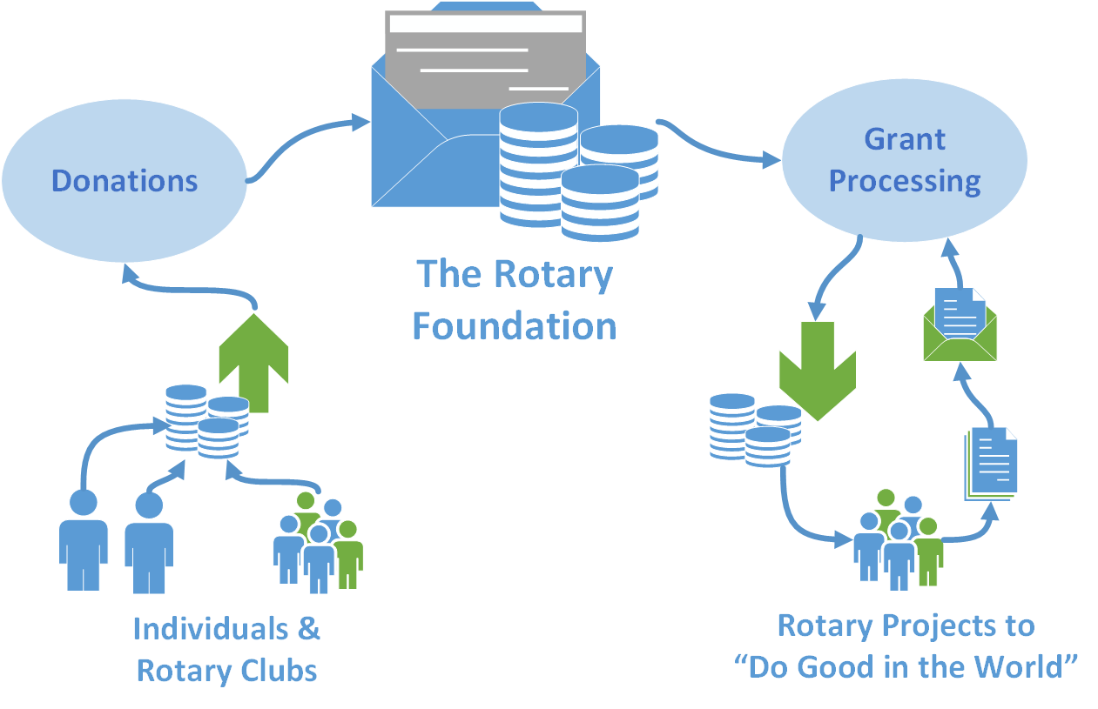
Foundation Funding - Projects
18

Slide 19
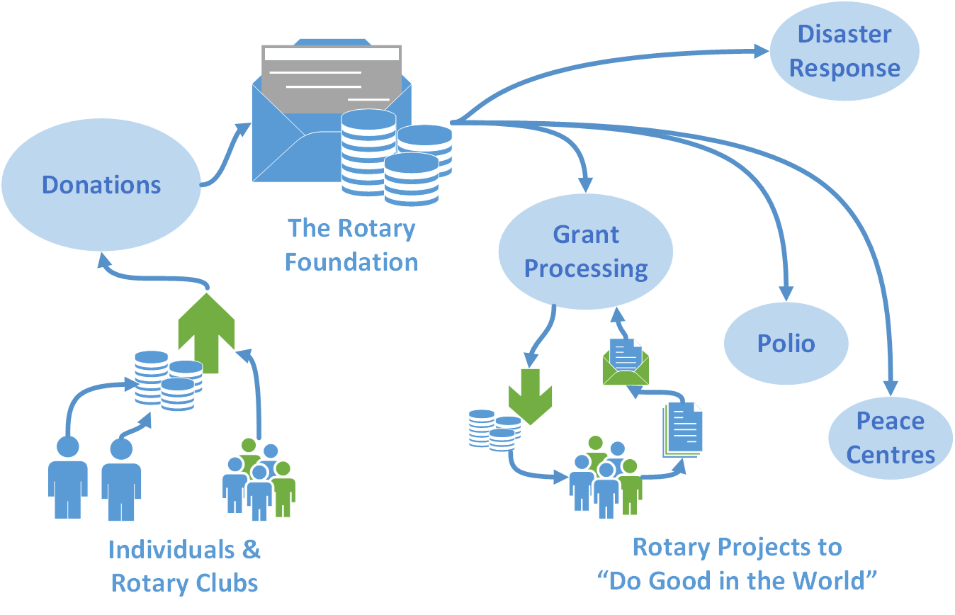
Foundation Funding – Projects Plus…
19

Slide 20
Grants – Funding Projects
20

Slide 21
Disaster Response Grants
Donations
Individuals, Clubs or Districts choose to donate specifically to Foundation Disaster Response Fund
Disaster Response Fund
Global fund from all those donations
Disaster Response Grants
No link between the funding source and District applying for the Grant

Slide 22
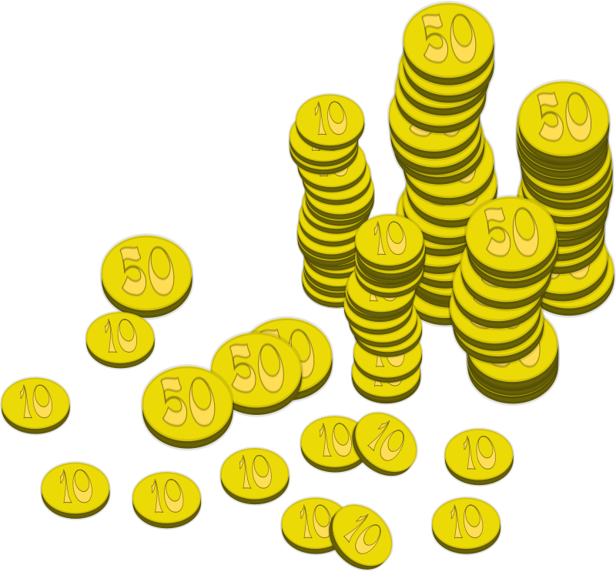

Which comes first? Funding or Project

Slide 23
Grant funding
Many grant giving organisations are available
All have specific funding criteria
Design the project to meet the criteria
  Foundation Global Grant projects for ‘Simple Schools’ or ‘Low Cost Shelters’ have very specific requirements
A finalised project will be harder to fund via grants

Slide 24
Rotary Foundation Criteria
Meet the Foundation mission statement
“To enable Rotarians to advance world understanding, goodwill, and peace through the improvement of health, the support of education, and the alleviation of poverty”
More specifically, there are Grant Terms & Conditions that are well documented, but are updated from time to time

Slide 25
District Grant Criteria
Small projects
  Maximum £600 funding per Club per project (per year)
  Club has to put in >=50% of project cost
  Has to have Rotarian involvement and / or a publicity opportunity
  Multiple Clubs can pool grant funding
Easiest option is to ‘buy something’ to present
  A unit cost allows the request to be ‘scaled’
  Estimate / Quote with application
  Receipts with report

Slide 26
Global Grant Criteria
Large projects
  Minimum $30,000 project budget
Needs to meet a community need
  Formal needs assessment required
Need to partner with Club(s) in another country
  >15% of the funding from outside the ‘project country’ (with the exception of Scholarships)
Needs to meet one or more Areas of Focus
  A primary Area of Focus is strongly advised

Slide 27

Areas of Focus
Peace and conflict prevention/resolution
Disease prevention and treatment
Water and sanitation
Maternal and child health
Basic education and literacy
Economic and community development
Environment (from 1st July 2021)

Slide 28

Areas of Focus

Slide 29
Two stage ‘matching’
Club(s)
Cash contributions from one or more Clubs
District(s)
District Designated Fund contribution
(determined by each District Foundation Committee)
World Fund
80% match for DDF contribution

Slide 30
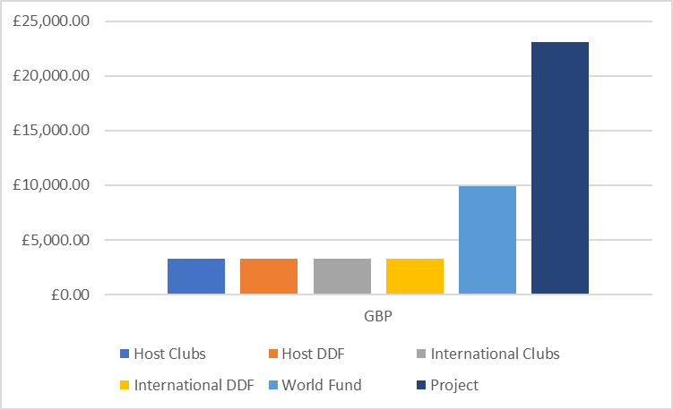
World Fund Matching
+ 100%
DDF(C+D) Contribution
Project Budget
World Fund
A
C
B
D

Slide 31
World Fund Matching
+ 100%
DDF(C+D) Contribution
Project Budget
A
C
World Fund
B
D

Slide 32
World Fund Matching
+ 100%
DDF(C+D) Contribution
Project Budget
A
C
World Fund
B
D

Slide 33
World Fund Matching
+ 80%
DDF(C+D) Contribution
Project Budget
A
C
B
D
World Fund

Slide 34
Matching – Figures for 85/15 split
So a group of Clubs can run a £21,300 project after raising a little under
£6,500

Slide 35
Global Grant Funding Example
Project Budget
Club
DDF
World
Fund

Slide 36
Global Grant Funding Example

Slide 37
Global Grant Funding Example

Slide 38
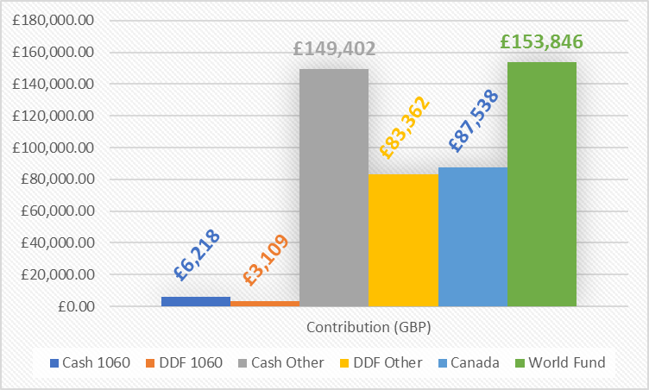

Guatemala Literacy Project 2019
183 Clubs
21 Districts
1 Country Govt
District 1060
£483,475
183 Clubs
World Fund
21 Districts
Rotary’s own Crowd Funding!

Slide 39
District Grant Specifics
39

Slide 40
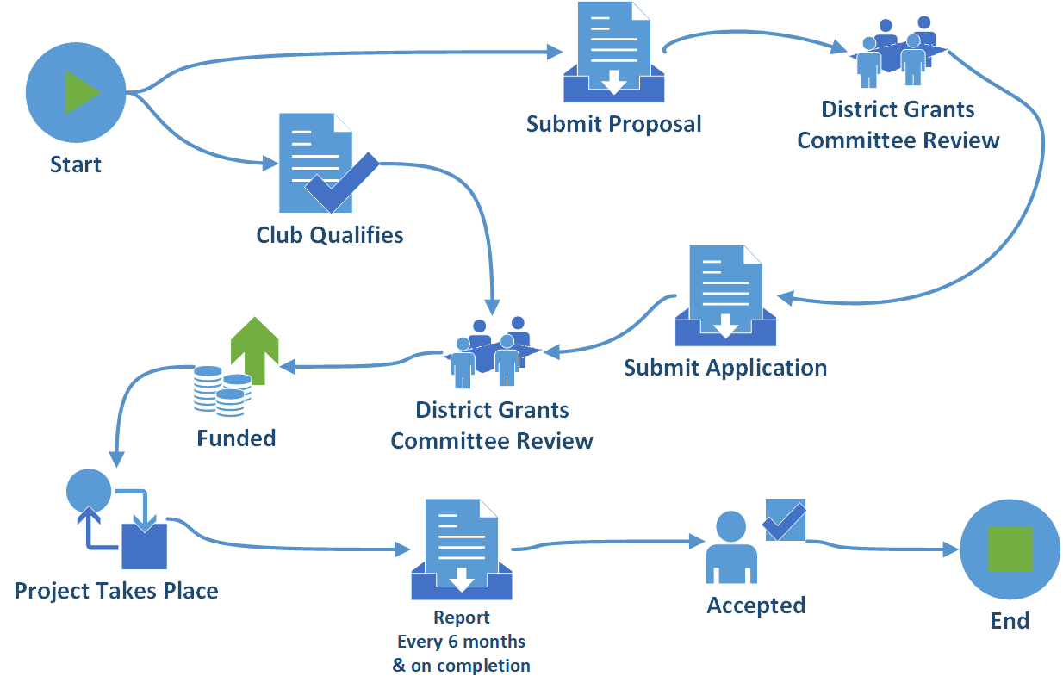
Process
40
Notes:
40

Slide 41
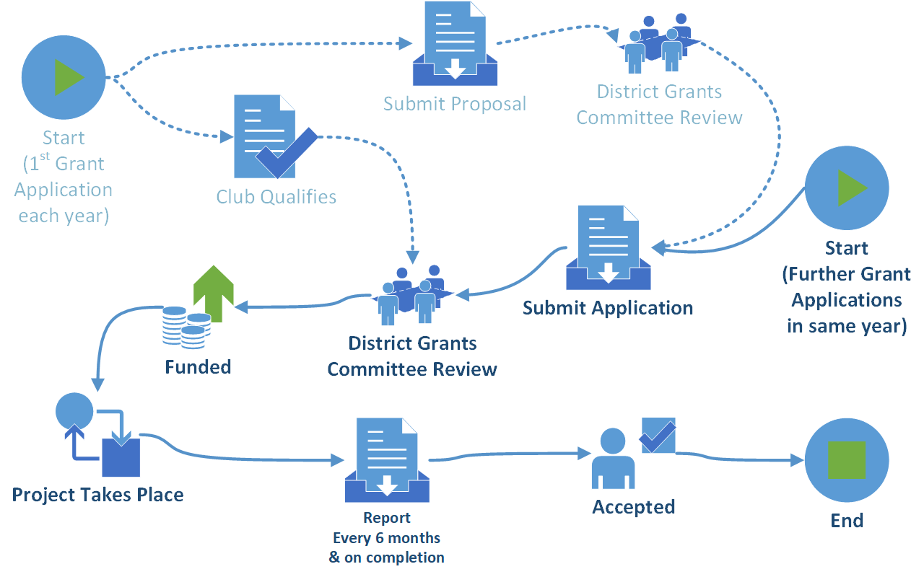
Process (further applications)
41
Notes:
41

Slide 42
Recommendation
If you have a suitable project idea for a District Grant project
Ideally with no time constraints
Submit it at any time for consideration when funds become available
42

Slide 43
Qualification
43

Slide 44
The purpose of Qualification
Qualification provides Clubs with financial and stewardship controls for meeting Foundation requirements and managing grant-funded activities.
Clubs need to qualify before applying for Global and District grants.
44

Slide 45
Qualification Requirements
Read, sign, and submit club “Memo Of Understanding” (MoU) to the District Foundation Committee
President and President Elect for the relevant Rotary year to sign (other Officers are available)
By signing the MoU, the Club agrees to comply with the requirements around stewardship and reporting

Slide 46
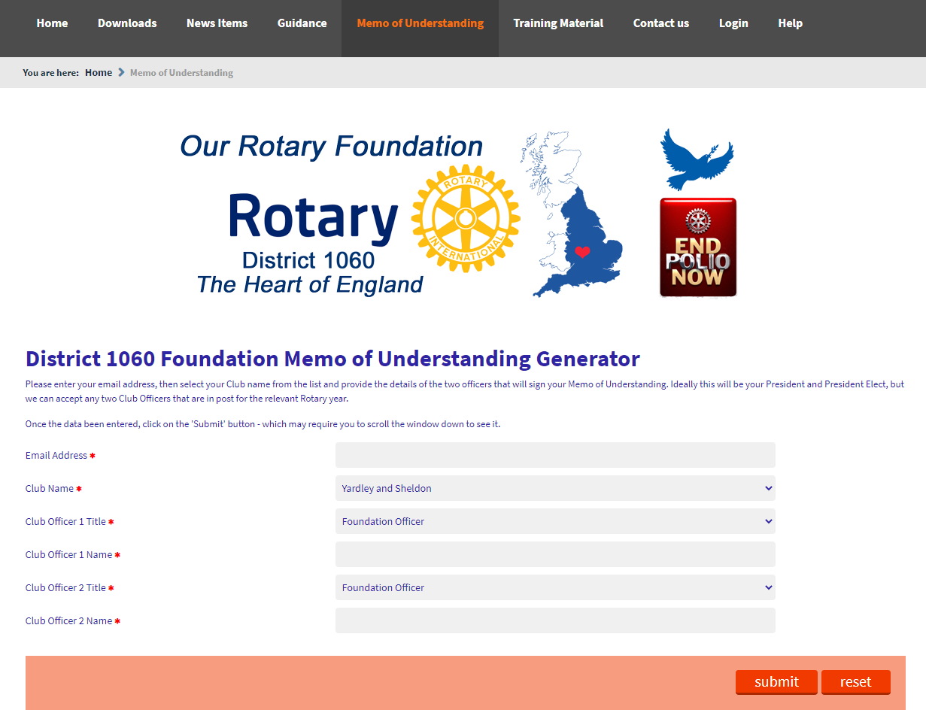
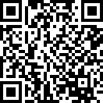
http://foundation.rotary1060.org.uk/memo-of-understanding
46

Slide 47
Giving & Recognition
47

Slide 48
How to give – via RFUK
Rotary Foundation (UK) is a UK registered charity that enables the use of Gift Aid
Donating direct to RF(UK)
  Cheque
    Specify the fund on the back
  Direct transfer
    Account details on the Foundation website
    Specify fund via the reference field
    Email RFUK team to confirm
  Standing Order
    Use Sustaining Member form as a reference will be provided

Slide 49
How to give – via RFUK
Club donation
  Cheque or direct transfer in the same way
  Gift Aid can be claimed by RF(UK) if you provide a schedule of payments stating how much each individual gave – as long as Gift Aid forms have been submitted

Slide 50
How … via District Treasurer
Cheque only
  Payable to ‘Rotary District 1060’
  Foundation (and fund) on the back
  Note that there will be a delay in recording the donation
Direct to RF(UK) is best to register the contribution within this Rotary year

Slide 51
How not to give…
Do not use the donation page on rotary.org!
  You will incur an exchange rate cost
  You will NOT be able to claim Gift Aid!

Slide 52
Giving
Two main options for regular donors
  Sustaining Member (>$100 per year)
  Paul Harris Society Member (>$1000 per year)
  Gift Aid to get a contribution from the Inland Revenue results in UK equivalents of £5.50 per month and £55 per month (1.25$->£)
  The same form works for both as the amount triggers the recognition type
52

Slide 53
How to check?
As a Club Foundation Officer, go to Rotary Club Central (on rotary.org)
Choose the “Foundation Giving” tab and then “Reports” on the left
Run the “Club Foundation Banner report” which shows if & when members achieve the categories (donation made, Sustaining Member, etc.) for the selected year
53

Slide 54
Recognition
For every $1000 given to Our Foundation, a Paul Harris Fellowship (PHF) can be awarded.
Again on the “Foundation Giving” tab of Rotary Club Central, the “Club Recognition Summary” report shows the credits / points available.
Consider “Certificate of Appreciation” for a school or company too.
54

Slide 55
Recognition – PHF Ordering
Via the rotarygbi.org login to My Rotary
Select ‘Club & District Support’
Select ‘Awards & Recognition’
PHF can then be chosen…
PHF Medals must be ordered from the RI Shop
55

Slide 56
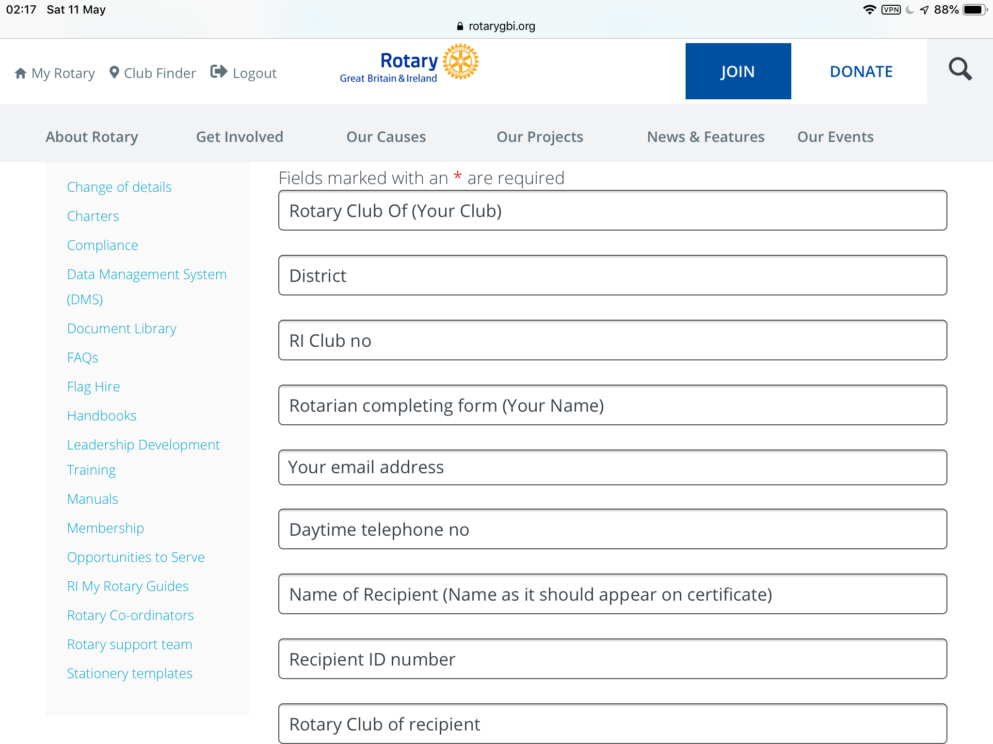
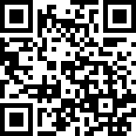
Recognition – PHF Ordering
56

Slide 57
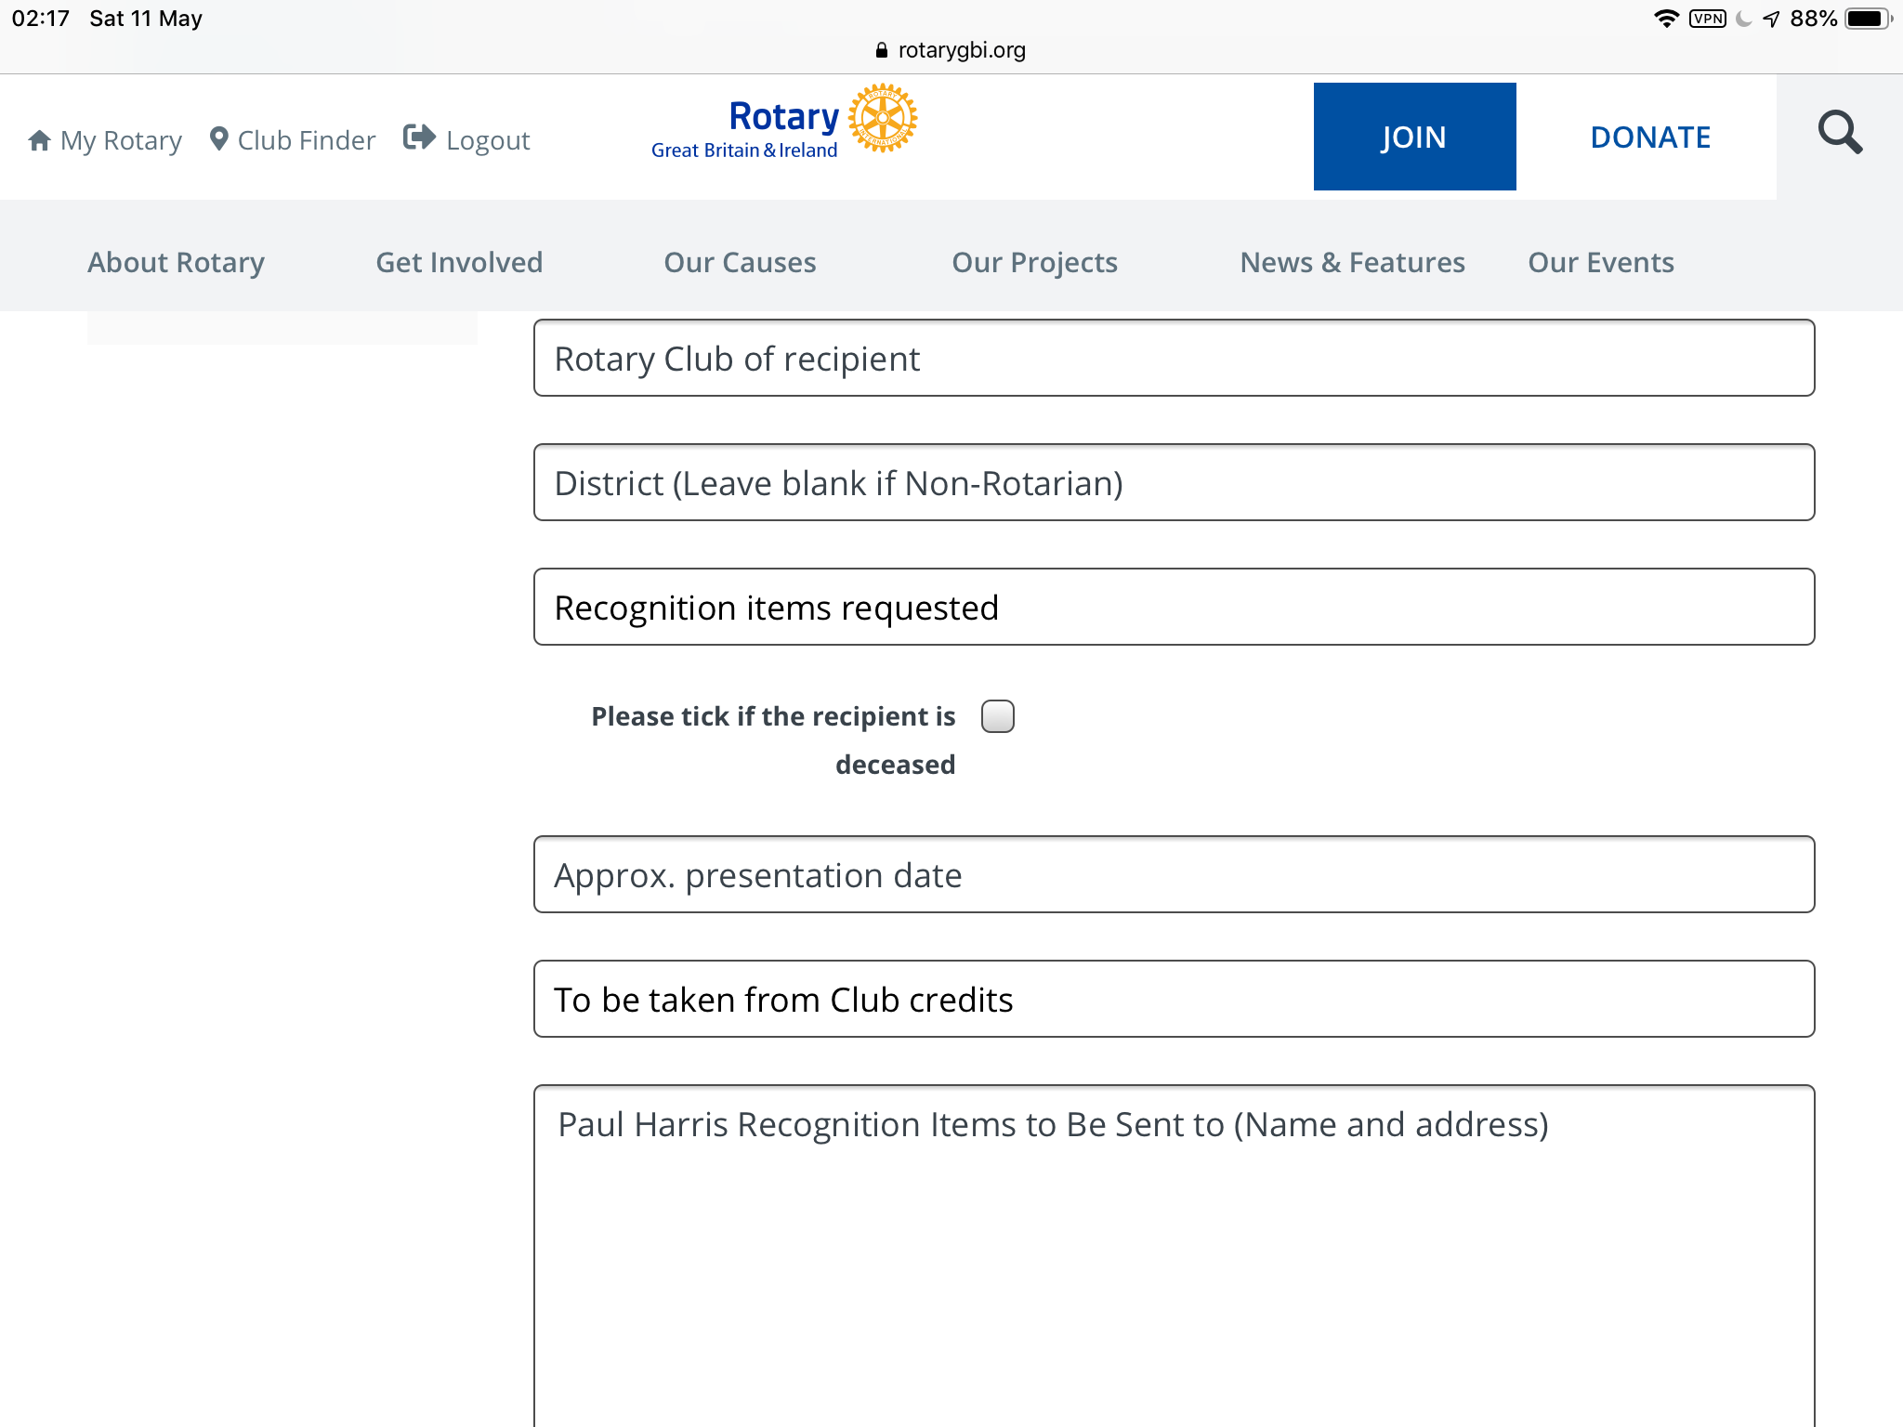
Recognition – PHF Ordering
57

Slide 58
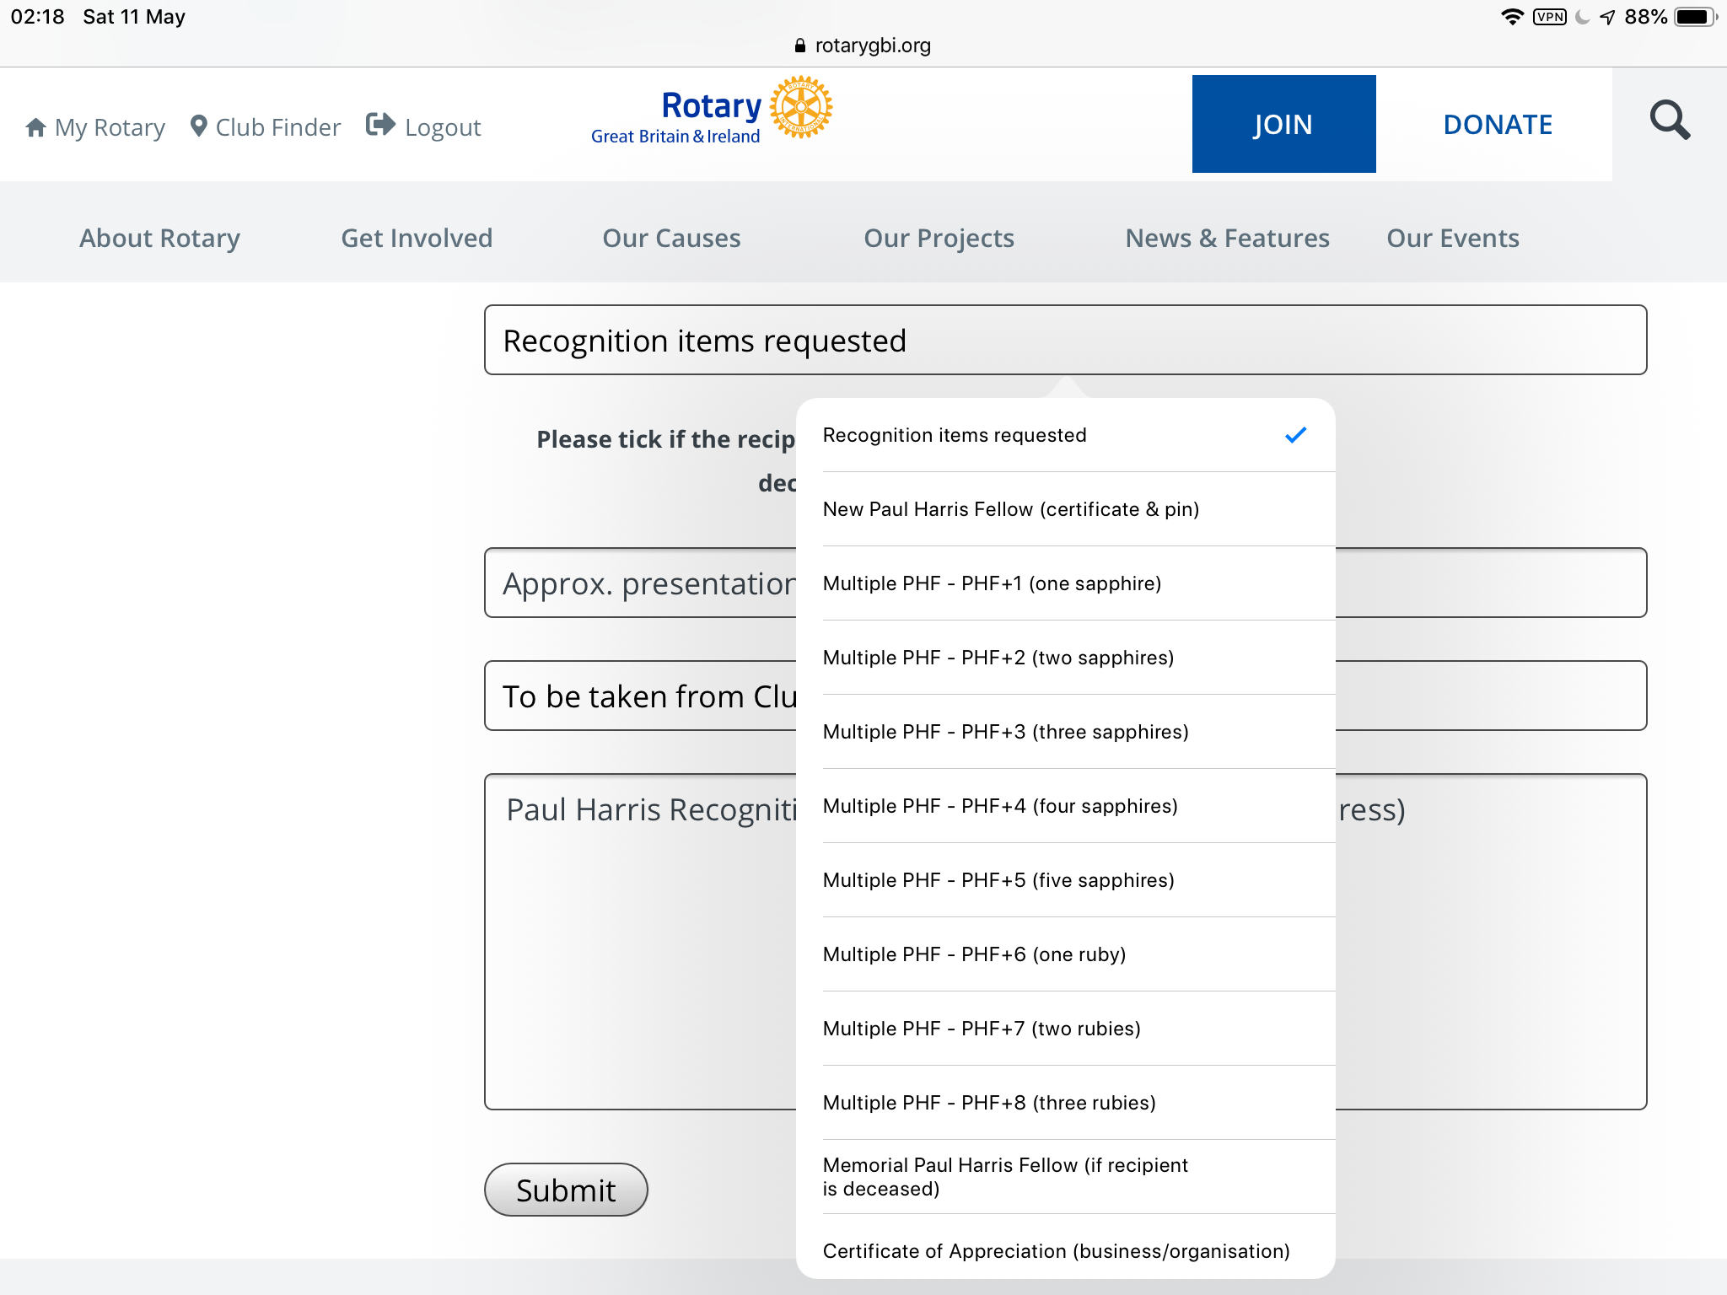
Recognition – PHF Ordering
58

Slide 59
Giving to our own charity
The projects we can fund
New DDF each year
It depends…
The Good we can Do
The size of the District Grant
On your support for our charity
59

Slide 60
Polio Eradication
60

Slide 61


Polio Update
Africa declared Polio Free – August 2020
World Polio Day 24th October
Two countries Polio endemic…
See https://polioeradication.org for updates
61

Slide 62

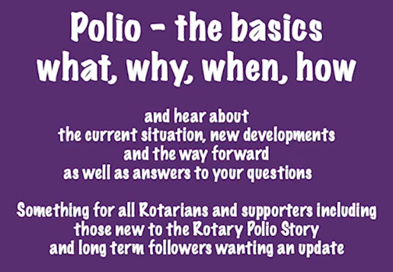

Broadcast Events
Recordings available via RotaryGBI Channel on YouTube
62

Slide 63
District 1060 Perspective
Steve McConnell
End Polio Now Officer

Slide 64
How to get your Crocus Corms
Peter Ramage
District Rotary Foundation Chairman

Slide 65
Peace
65

Slide 66
Rotary World Peace Fellows
66

Slide 67
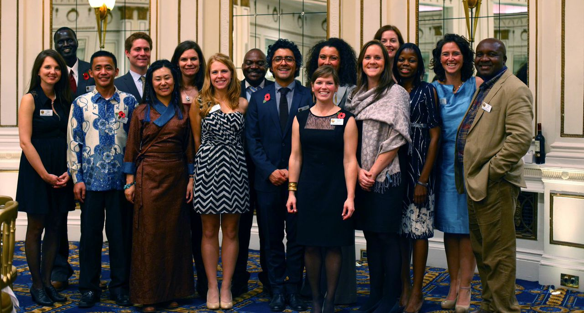
Class XIII Peace Fellows
67
Notes:
The Rotary Centers Major Gift Initiative shares the stage with PolioPlus as one of TRF’s highest priorities. Unlike PolioPlus, which is a broad-based initiative, the Rotary Peace Centers Initiative emphasizes gifts of US$50,000 or more. The Rotary Foundation Trustees, at their October 2014 meeting, increased the Rotary Peace Centers Major Gifts Initiative goal to $150 million by 30 June 2017 to build a permanent endowment for the program. The goal increase is based upon a financial analysis of the program elements adopted in the Rotary Peace Center Strategic Plan. Both endowed and term gift naming opportunities are available. The goal primarily underwrites the Rotary Peace Fellows, including tuition, transportation, housing, and other related educational expenses. It also covers program operations, including modest stipends for the universities and activities such the Rotary Peace Symposia.
The focus of the Rotary Peace Centers Major Gifts Initiative is endowed gifts, but it is expected that about 10 percent of the gifts that come in will be term (immediately expended) gifts to help with the ongoing expenses of running the program.
About 3,500 individuals from throughout the world have contributed about 5,900 gifts and commitments to The Rotary Centers.

Slide 68
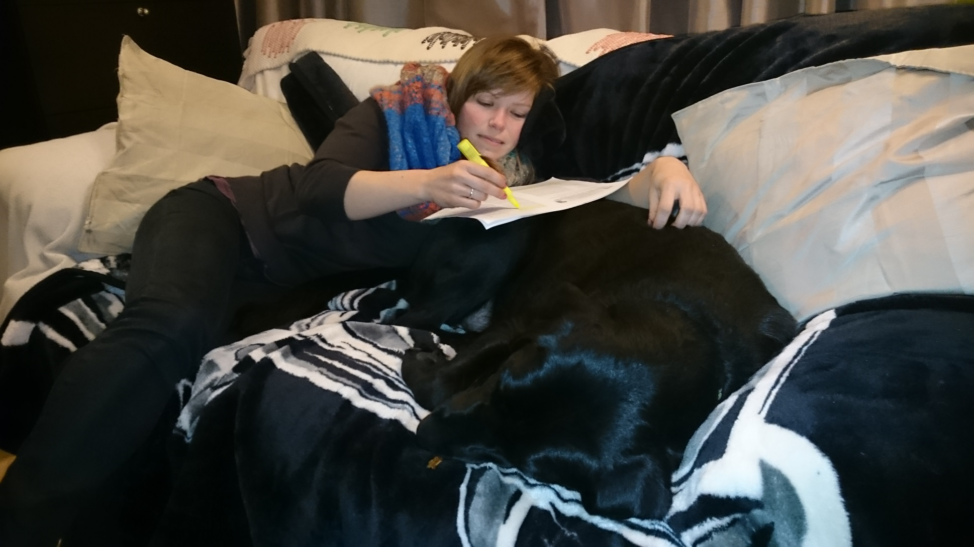
Meg Fenton (2015)
68

Slide 69

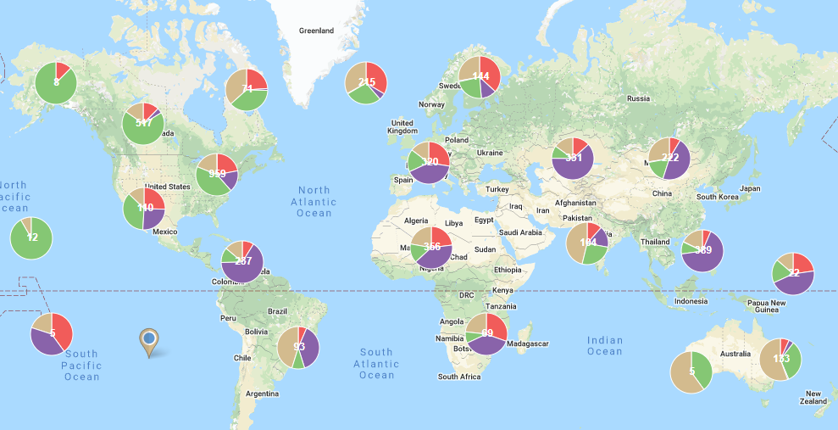
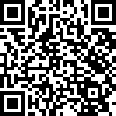
Rotarian Action Group for Peace: PeaceHUB map
Rotarian Action Group for Peace
Mission: Serve as a resource to Rotarians, Rotary clubs,
  and districts by supporting the peace work of Rotarians worldwide.
  www.Rotarianactiongroupforpeace.org
69
Notes:
The Rotarian Action Group for Peace, a very active group of Rotarians dedicated to supporting the peace work of Rotary and Rotarians worldwide has been making tremendous strides this year. They are a great resource for Rotarians, Clubs, and Districts who are interested in the field of PCPR.
The Rotarian Action Group for Peace has developed an interactive map of Rotary peace resources called the PeaceHub. This tool maps Rotarians working on peace projects, rotary peace fellows, nonprofit organizations working in the field of peace and conflict resolution, and educational institutions offering degrees/trainings in fields of peace and conflict resolution.

Slide 70
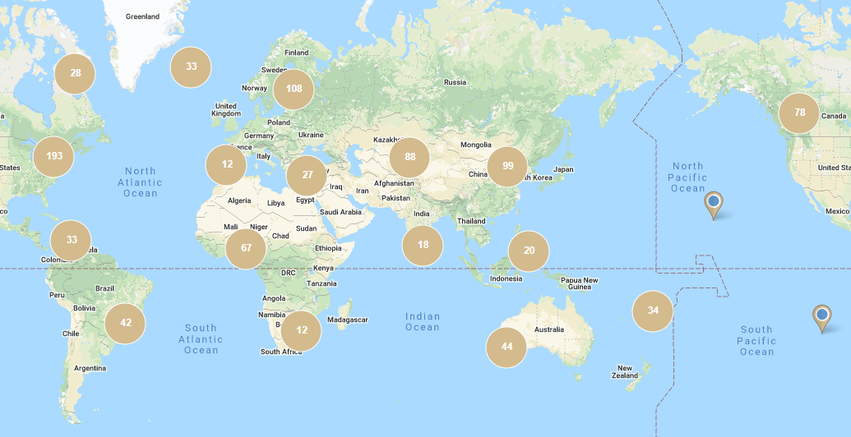
Rotary Peace Fellow alumni locations
31.3% North America
28.3% Asia
16.1% Europe
3.1% South America
11.2% Africa
10.0% Australia/Oceania
Notes:
This map shows the approximate distribution location of the nearly 1000 Rotary Peace Fellows working in over 100 countries around the world. Peace fellows are scattered across the globe on every continent.

Slide 71
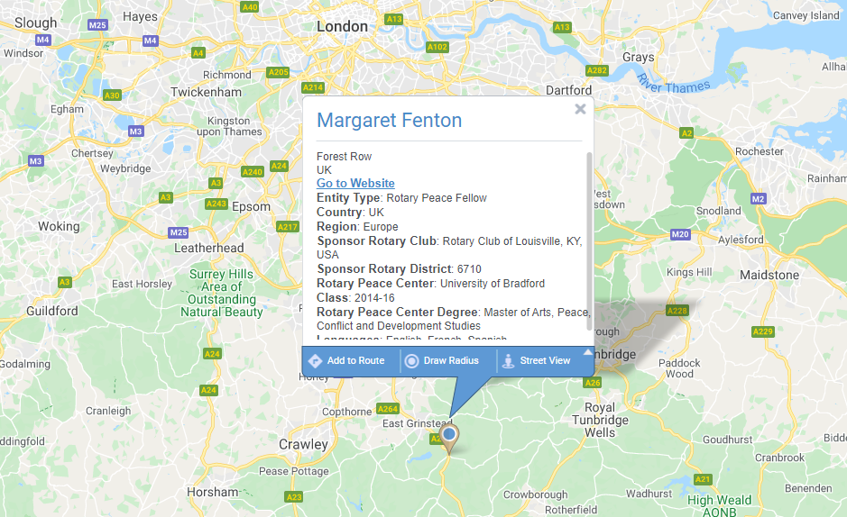
Rotary Peace Fellow alumni locations

Slide 72
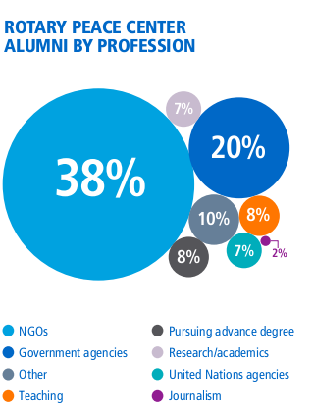
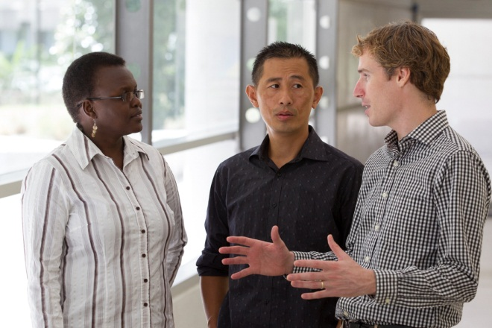
Alumni Updates
Notes:
Rotary Peace Fellows work in a variety of professions:
38% work for NGOs
20% work for government agencies
16% are working in research/academia, or pursuing PhDs in peace related fields
7% work specifically for UN agencies (that equates to 65 fellows)
8% are teachers/professors
The following are a couple examples of peace fellow alumni working in these areas:

Slide 73

Doing Good – Promoting Peace

Slide 74
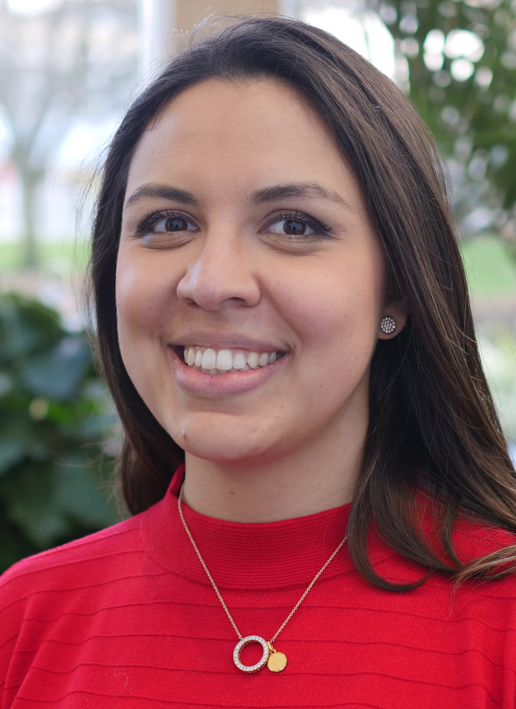
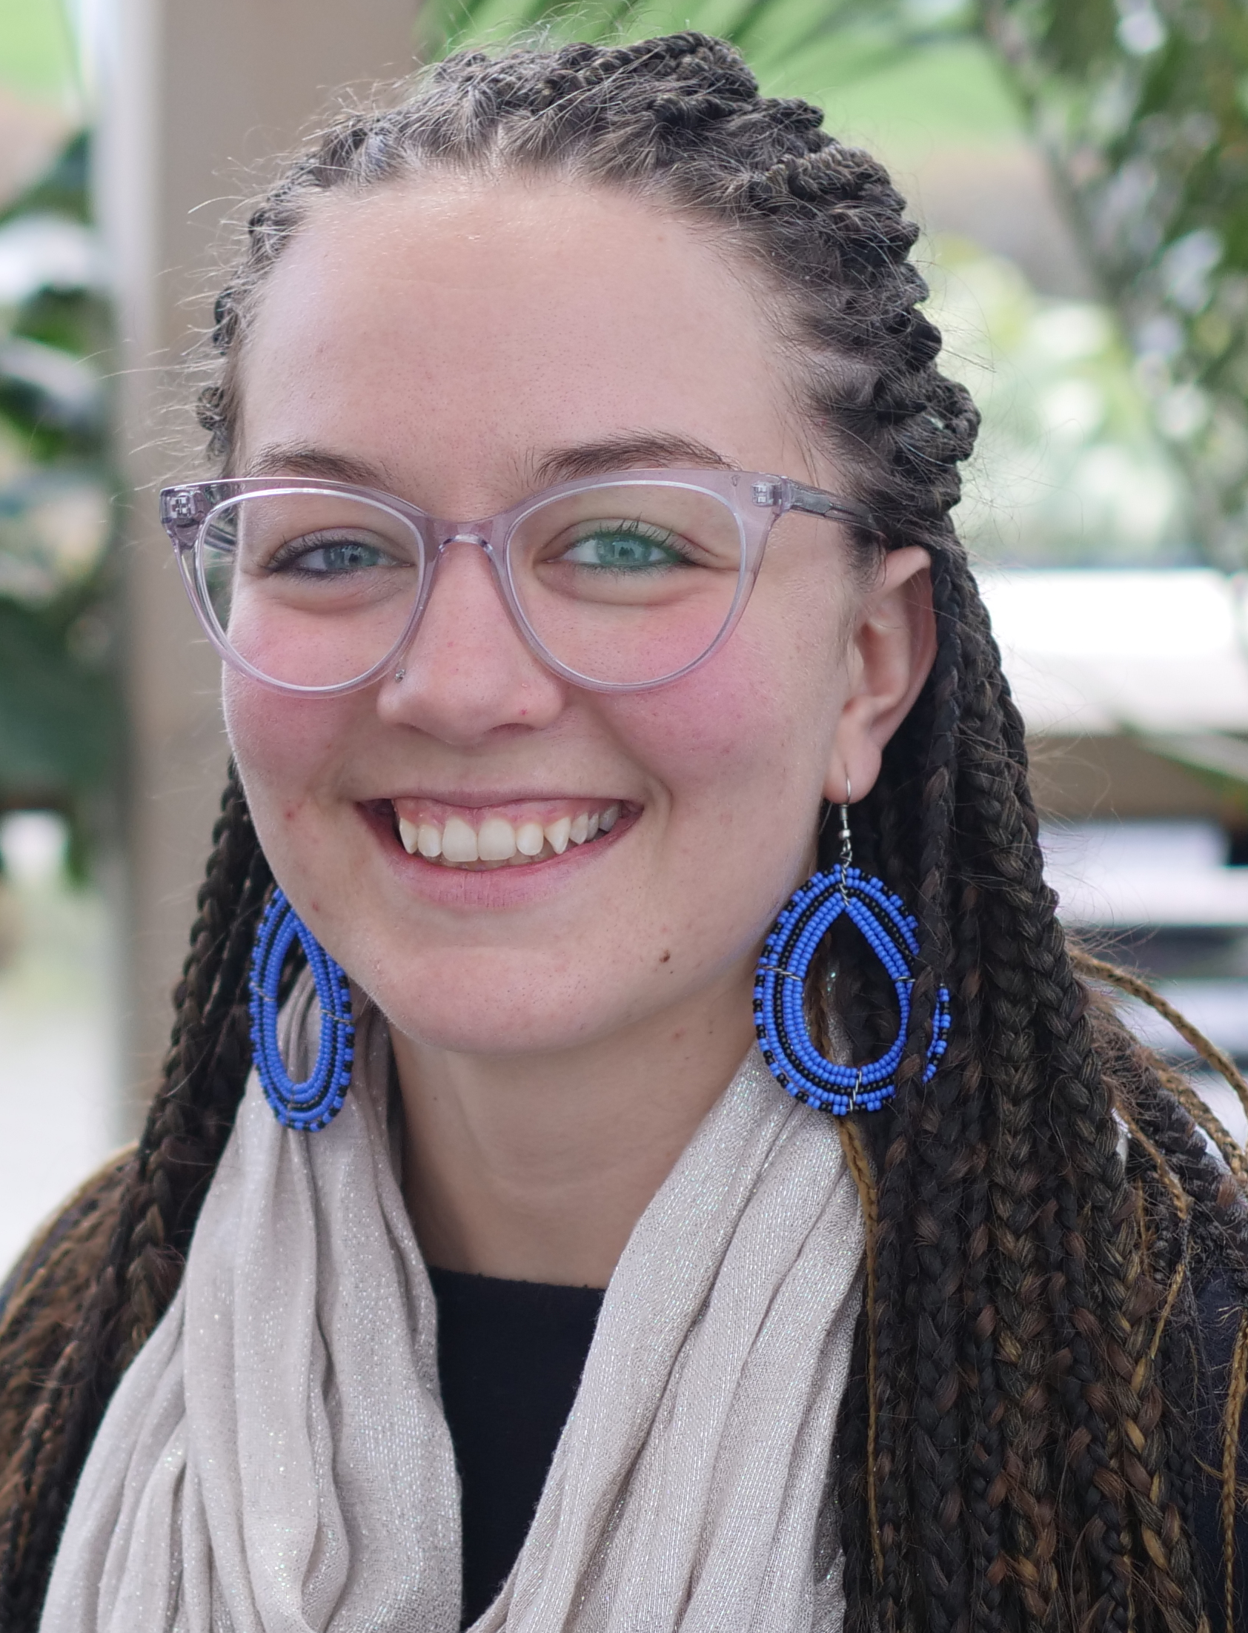
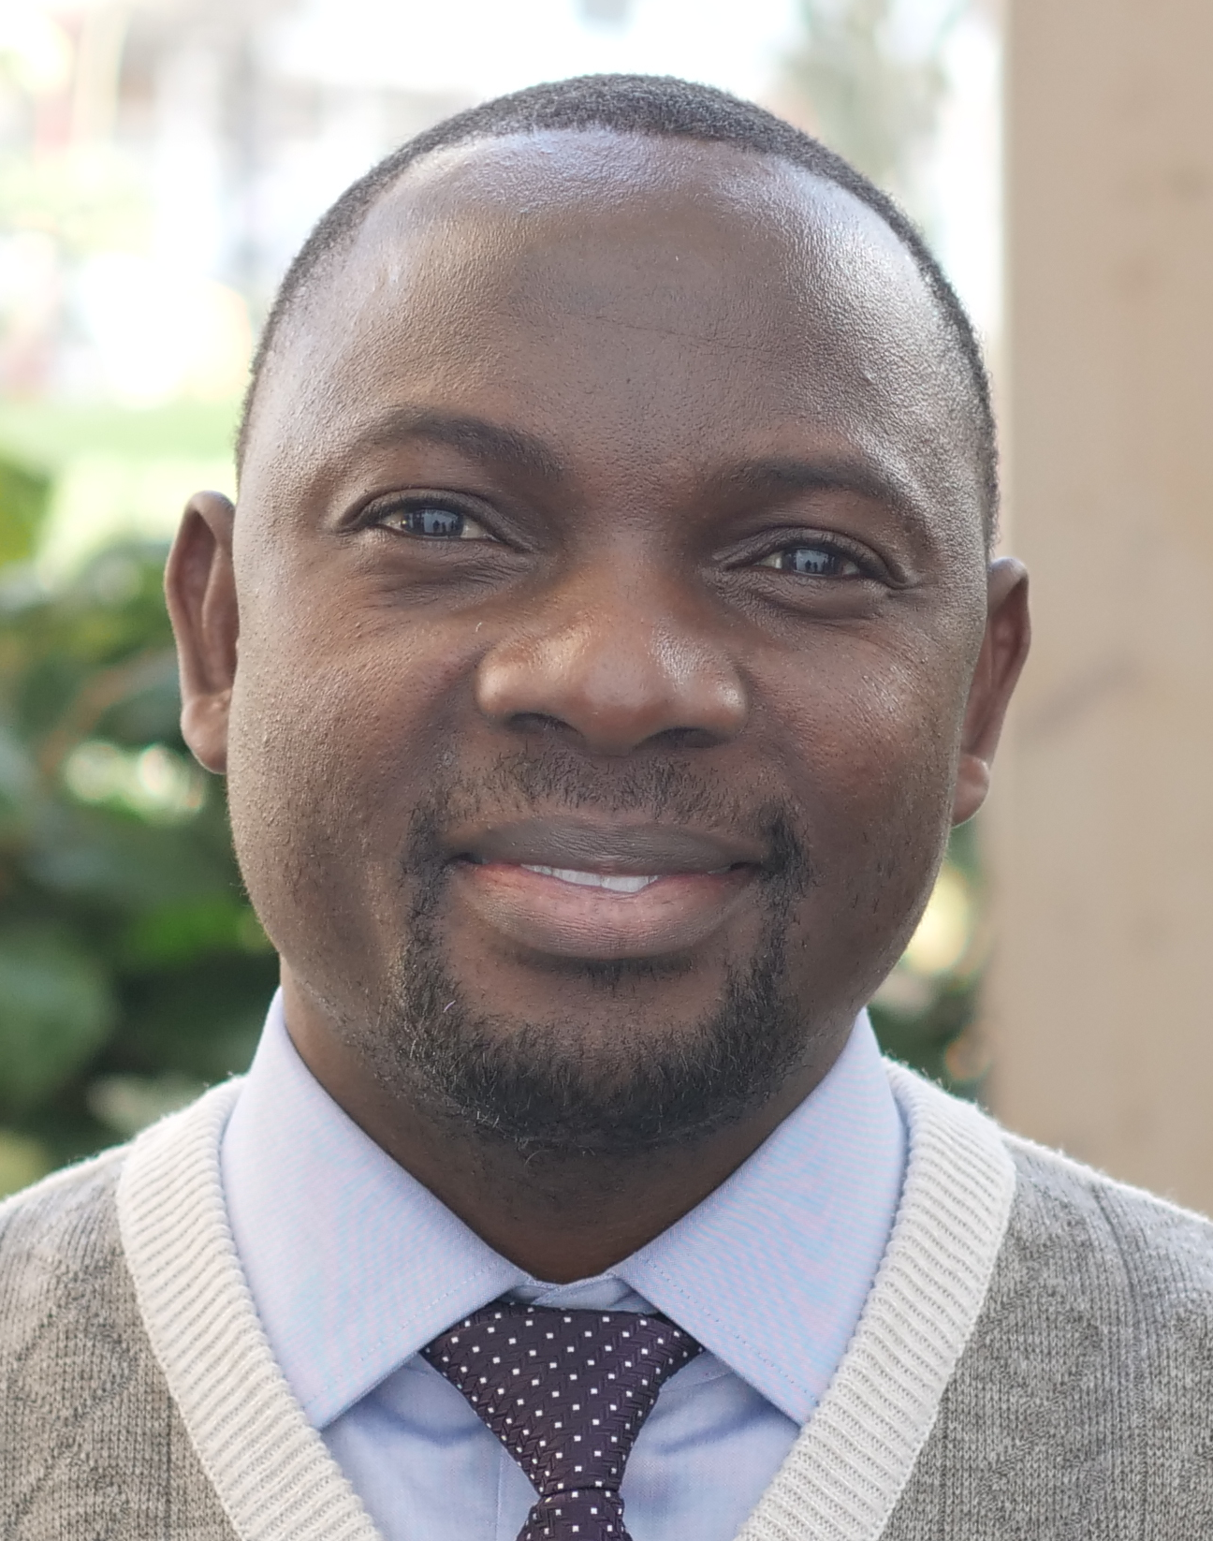
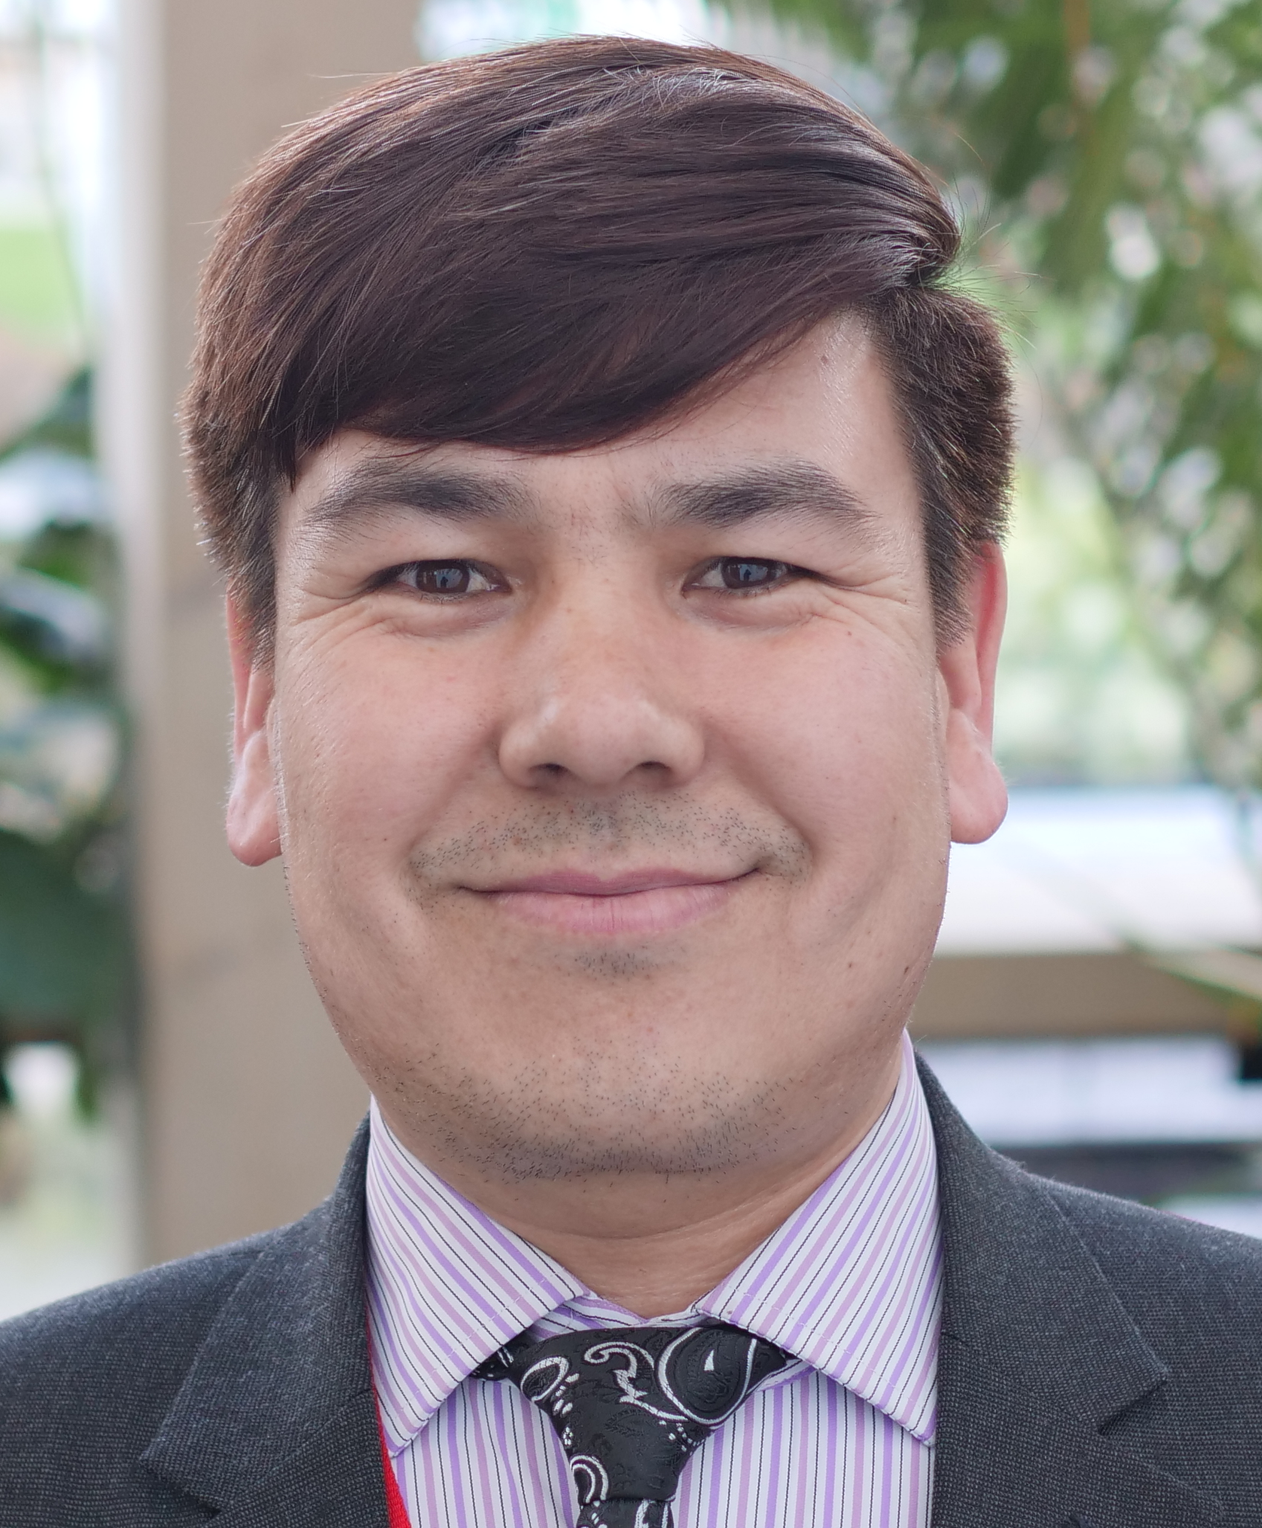
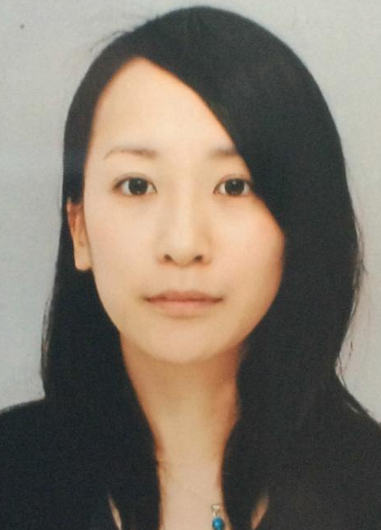
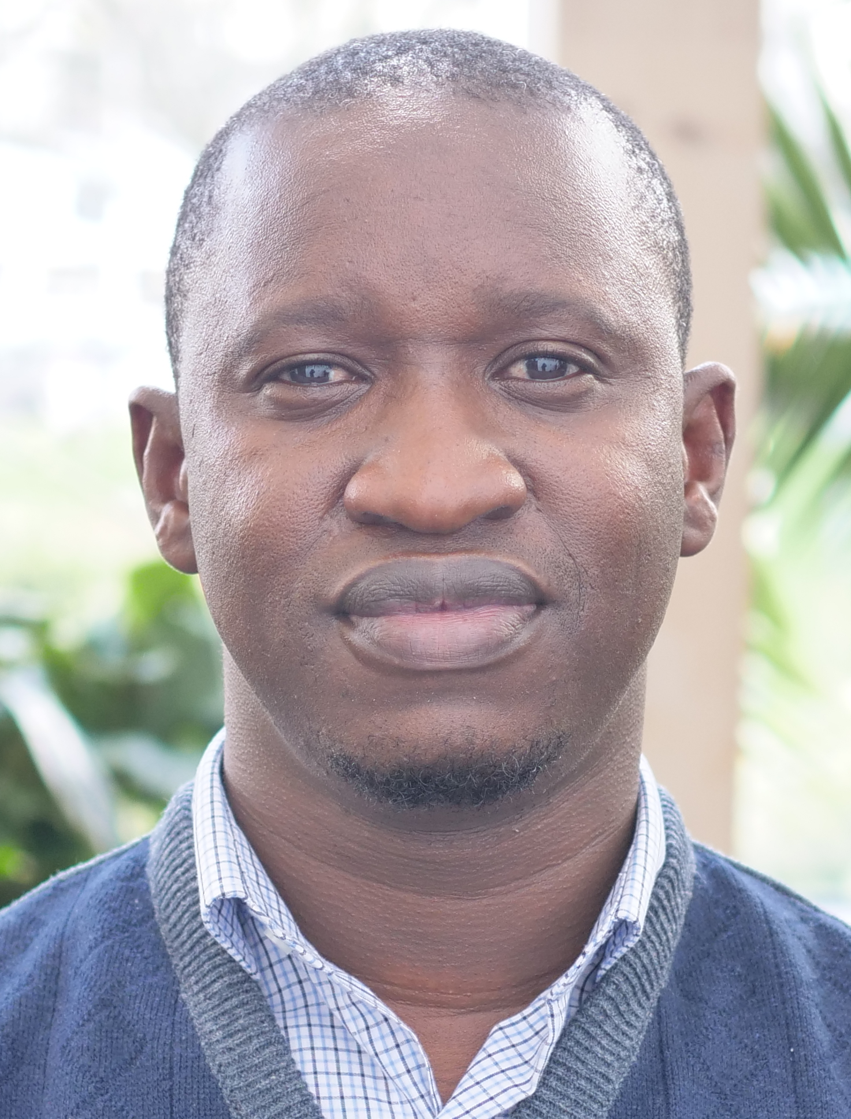
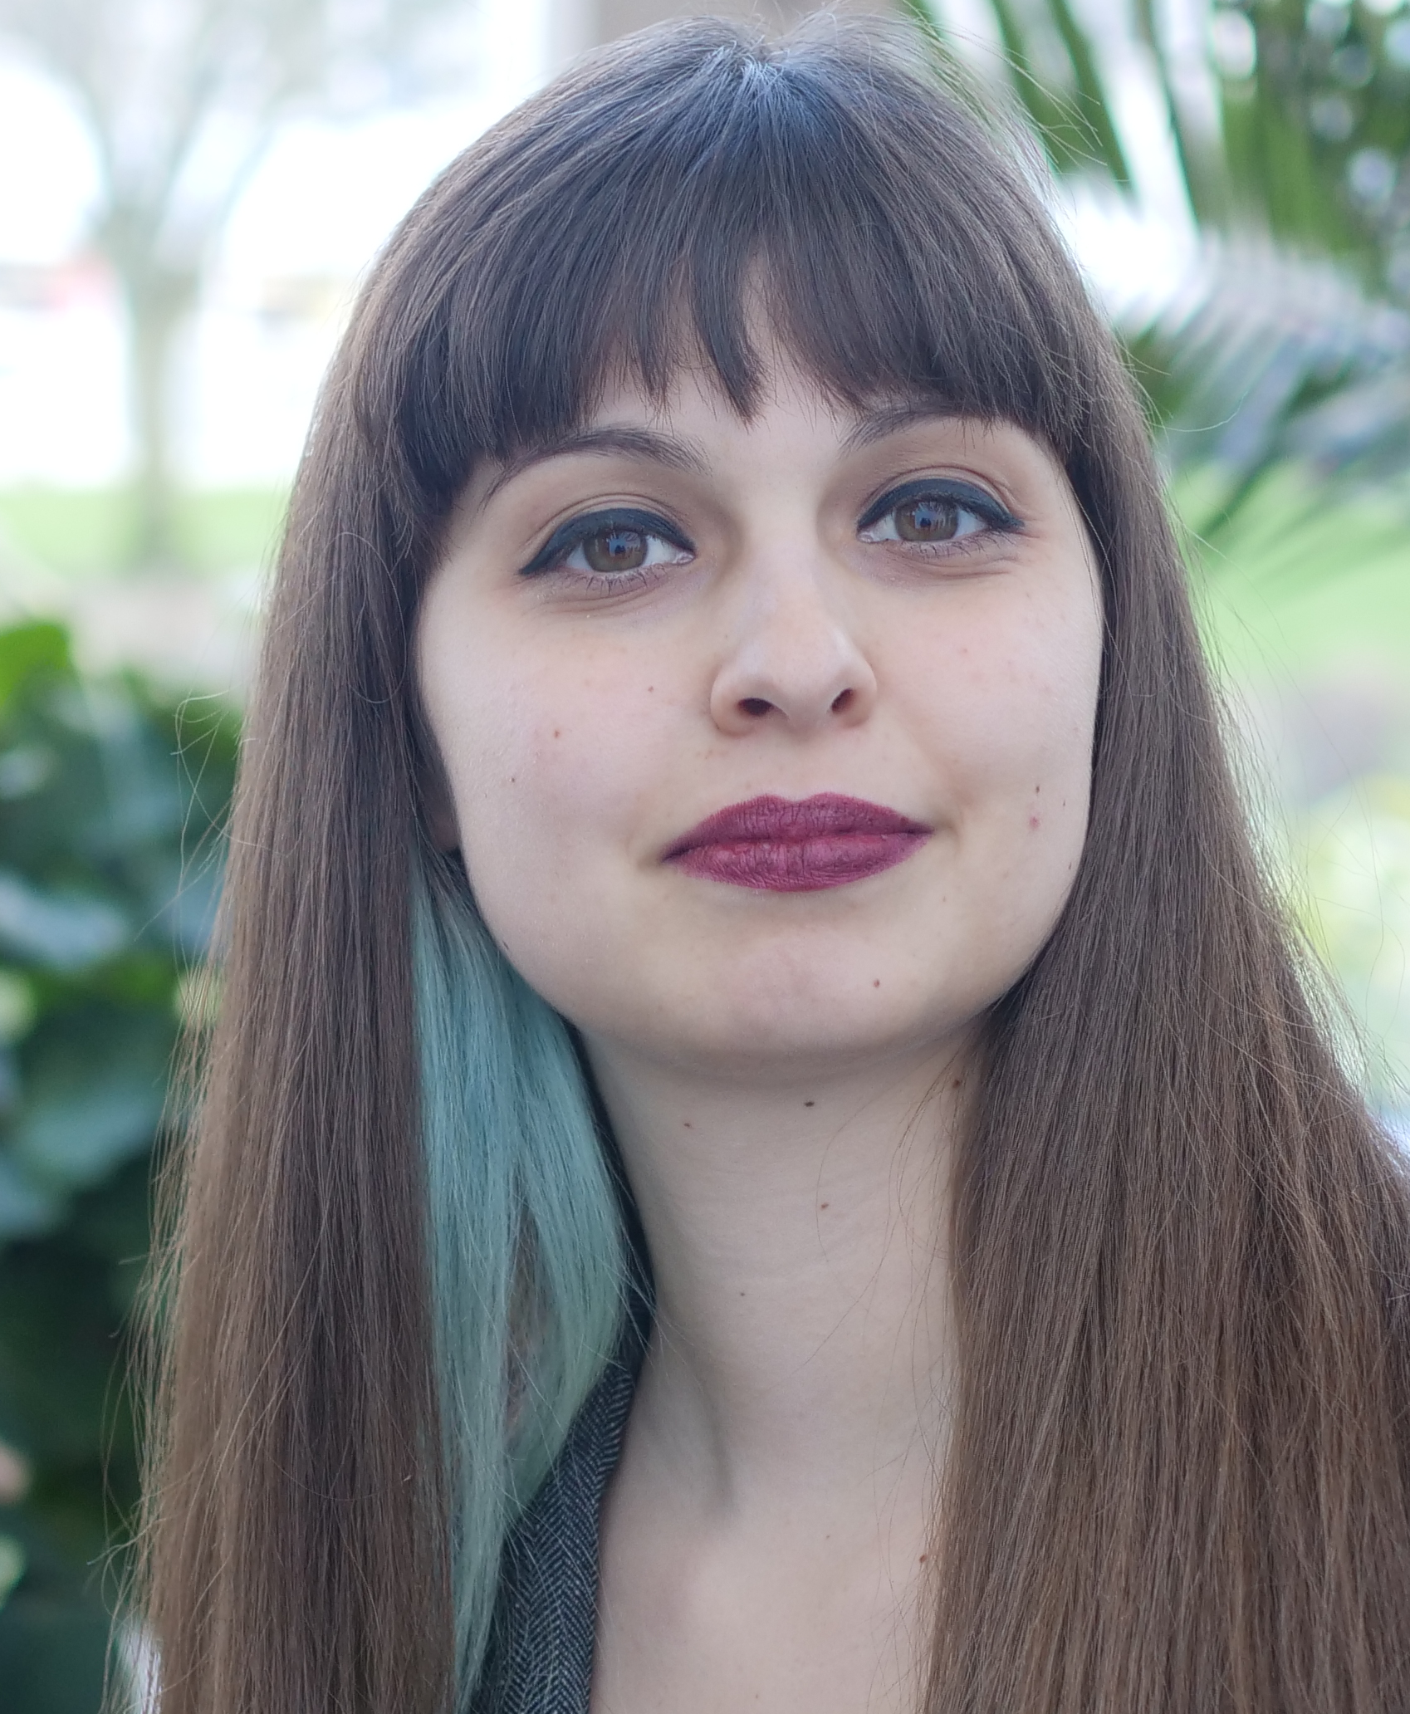
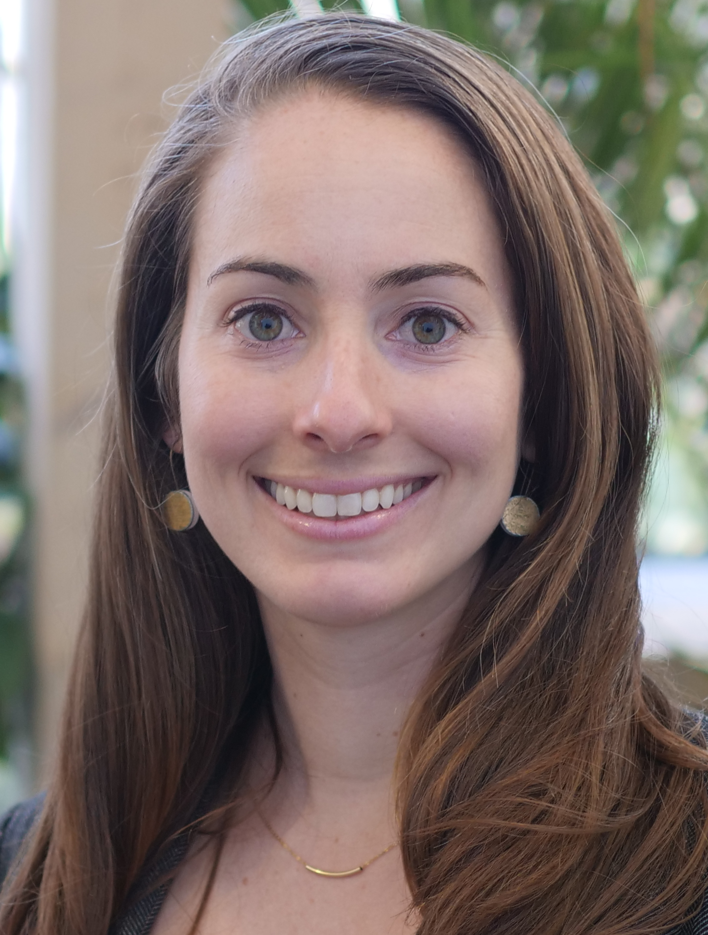
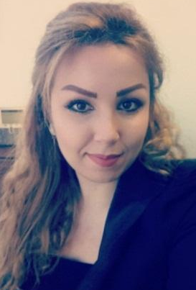
Bradford - 2018-19 (Class XVII)
Ana Lucía
Guatemala
Camillia
USA
Chance
Malawi
Hassan
Afghanistan
Kiyomi
Japan
David
Gambia
Elif
Turkey
Julia
USA
Ghenwa
Syria

Slide 75
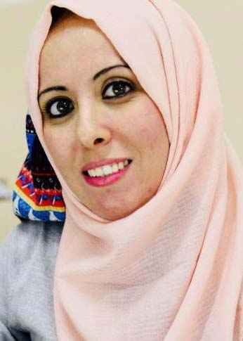
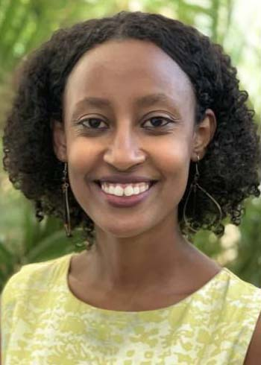

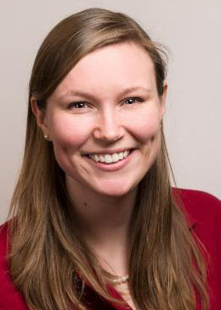
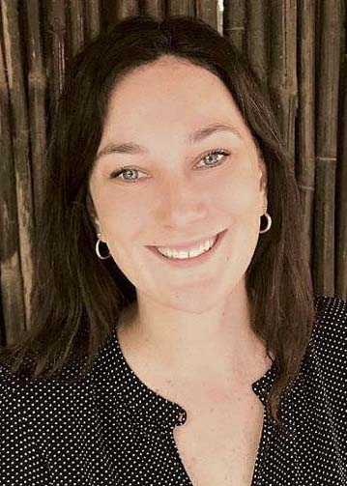
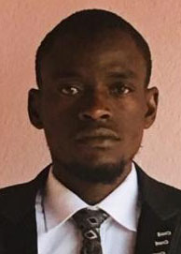
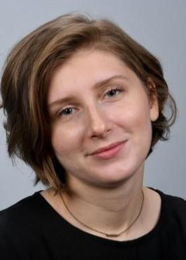
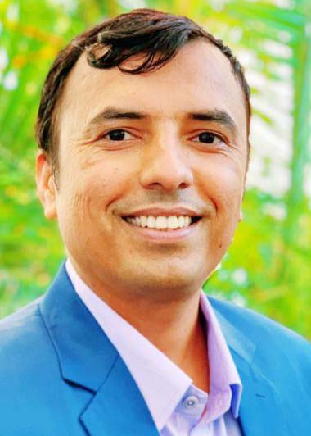

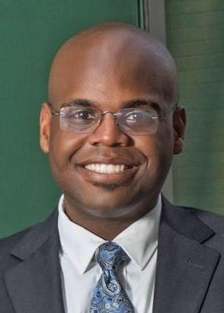
Bradford - 2019-20 (Class XVIII)
Nabila
Palestine
Meklite
Ethiopia
Maria
Columbia
Rachel
USA
Ellie
Canada
Idrisa
Liberia
Gaia
USA
Madhav
Nepal
Maia
Georgia
Terence
USA

Slide 76
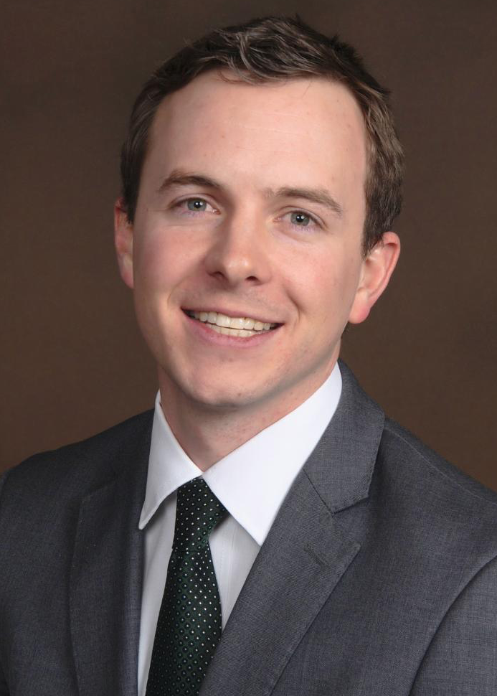
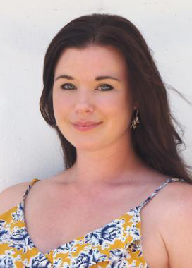
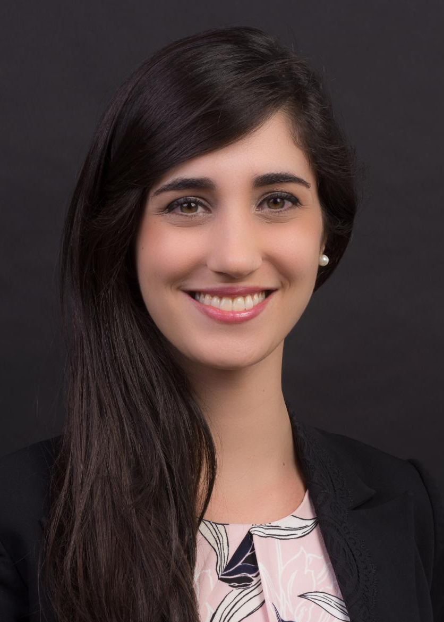
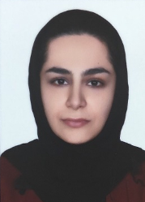
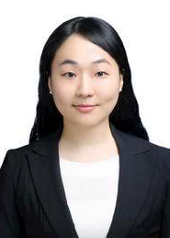
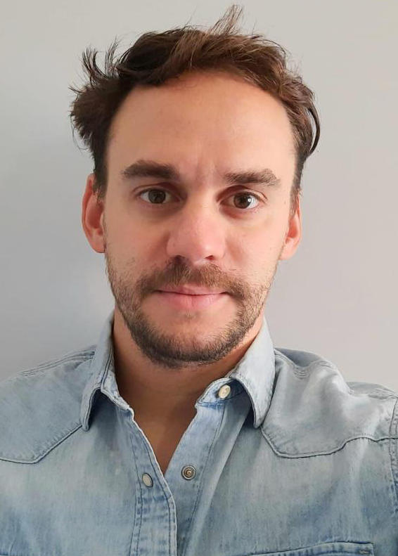
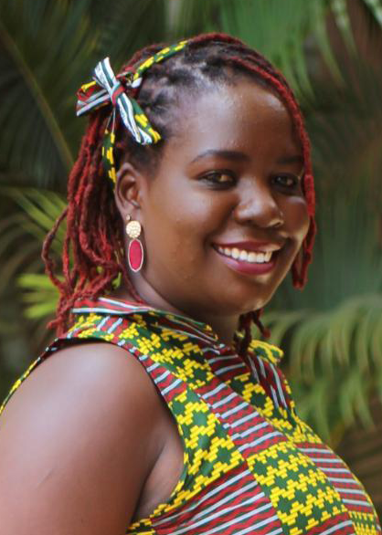
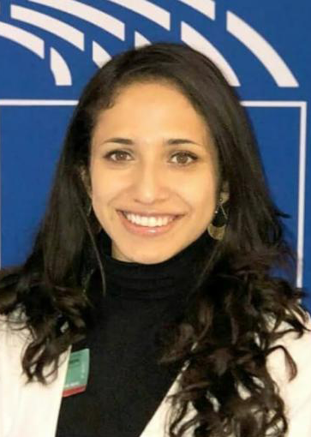


Bradford - 2020-21 (Class XIX)
Chris
USA
Eva
Australia
Flavia
Brazil
Homeyra
??
Jeeyoung
South Korea
Juan
Argentina
Juliet
Uganda
Maria
Columbia
Peter
Kenya
Shannon
USA

Slide 77
Future Peace Events
Bill Huntley Memorial Peace Seminar
  31st October 2020 @ Bradford University
  “Meet the Fellows Dinner” – 30th October
Rising Global Peace Forum
  11th-13th November 2020 @ Coventry University
  Run by Centre for Trust, Peace & Social Relations

Slide 78

Scholarships
Rotary Scholar with two Peace Fellows

Slide 79

Further information
Rotary.org for Rotary Club Central reports and the Grants Center.
Updates via Newsletters and on http://foundation.rotary1060.org.uk
Consider donating to Foundation to make funding available for future projects
  Please don’t leave it to the end of the year ☺

Slide 80

Q&A
Final opportunity for questions…
grants.rotary.org
foundation.rotary1060.org.uk

