Slide 1
The Rotary Foundation
An Overview
Paul Beedham
District Rotary Foundation Chairman 2016-19
Peter Ramage
District Rotary Foundation Chairman 2019-22

Slide 2
Setting the scene

Slide 3
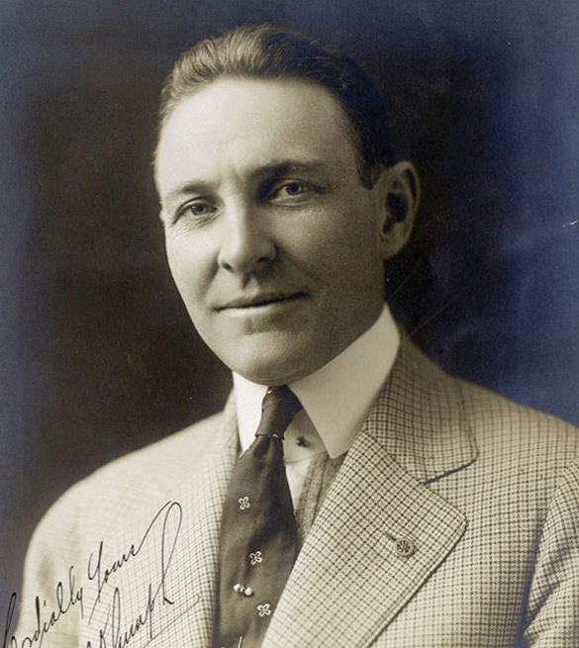
How did it all start?
1917
  Rotary International President Arch Klumph proposes an endowment for doing good
1928
  Formally named The Rotary Foundation
1947
  Paul Harris dies and Rotary sends out a telegram passing on his desire for donations to the Foundation in lieu of flowers…

Slide 4


Contribution History ($27.50 – Millions)
250
^{millions of dollars}
200
150
100
50
0
1917
1949-50
1954-55
1959-60
1964-65
1969-70
1974-75
1979-80
1984-85
1989-90
1994-95
2004-05
2009-10
2014-15
1948-49
1999-2000

Slide 5
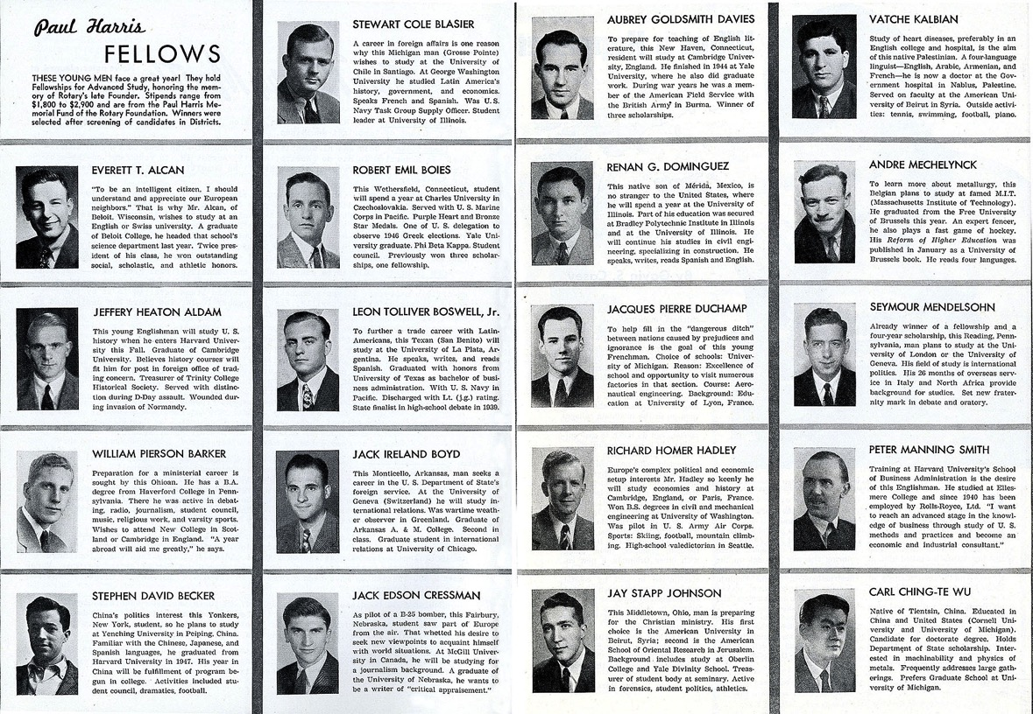
First Programme – Scholarships

Slide 6
The Mission
Original objective
  “Doing Good in the World”
Mission statement
  “To enable Rotarians to advance world understanding, goodwill, and peace through the improvement of health, the support of education, and the alleviation of poverty”

Slide 7
How it works

Slide 8

A tale of four funds
Annual
Fund
Donations
Permanent
Fund
Polio
Fund
Disaster Response Fund
Notes:
The Annual Fund is the ‘default’ when someone donates to The Rotary Foundation. It is the core project fund that will be used in three year’s time to provide the District with its new District Designated Fund (DDF) allocation.
The Permanent Fund usually receives donations from legacy (contributions from wills). It is not spent, with the income from the fund being added to the Annual Fund donations to boost the new DDF allocation.
The Polio Fund is specific to the Polio Eradication work.
The Disaster Relief Fund is new and is explained on the next slide.
8

Slide 9
Disaster Response Grants
“Districts that have been affected by a disaster can use Rotary disaster response grants to launch their own projects or work with established relief organizations to help their communities recover. Districts should work closely with local officials and groups to ensure that the funding will meet a specific community need.”
Maximum of $25,000
Can also use Global Grants & District Grants
Contributions made directly to the Disaster Response Fund

Slide 10

Three year investment
2017-18
Annual
Fund
2020-21
Project
Funding
Permanent
Fund
Spendable Earnings
Notes:
The donations made to the Annual Fund in 2016-17 are invested for three years, with the return on investment being used to cover the costs of running The Rotary Foundation. Those donations then create the Project Funding for the Rotary year 2019-20.
The earnings from the Permanent Fund add to that available Project Funding.
10

Slide 11
Global / Local Projects
World
Fund
50% of Every District’s
Annual Fund
District
Designated
Fund
Per District
(x 500+)
Notes:
The Project Funding is split into two. Half from every District makes up the World Fund, with the other half being returned to the control of the District as the new District Designated Fund (DDF).
11

Slide 12
Balanced Global Funding
2017-18 Average Donations per Rotarian
  Globally = $113 (£87)
  District 1060 = $39 (£30 with £9 within subs)
We contributed less than half the average, but still have access to the same World Fund

Slide 13
District Designated Fund
50% of
contributions
3 years prior
£23,884
Rollover and
Transfers
DDF
Up to 50%
£4,860
District
Grants
Global
Grants
PolioPlus
Donations
Unused DDF
rolls over to
next year
£11,942
Transfer to
another
district
Rotary Peace
Centres
Donations
£20,042
£29,160
to Polio
Notes:
13
DDF rolls from one year to the next, with 50% of the donations made three years ago to the Annual Fund (plus the earnings from the Permanent Fund) being added in at the start of each year.
Up to 50% of the new DDF can be spent on a District Grant, with the rest available to boost Global Grant funding, or donate directly to Polio, Peace Centres or to another District.
The beauty of the DDF donation to Polio is that it is matched first by the World Fund and then twice by the Gates Foundation – significantly magnifying the value.
For District 1060 - New DDF for 2019-20 = $38,900.88 (£29,923.75)
District Grant Max = $19,450.44 (£14,961.88) plus bonus $29,450 (£22,654)
Polio (20%) = $7,780.18 (rounded to $7,800) (becomes $15,600 after World Fund match of 100% and $46,800 after Gates Foundation match of 200%) or £36,000
Rolling total = $105,691.19 (£81,931.16)

Slide 14
Special Offer!! – Going, going…
$20,000 DDF boost for two District Grants
New DDF
  2019-20 $38,900
  2020-21 $29,486
District Grants
    2019-20 $19,450 + $10,000 = $29,450 (£22,654)
    2020-21 $14,743 + $10,000 = $24,743 (£20,042)
  Next year is back to normal…. ☹

Slide 15
Coming soon….

Slide 16
Grants – Funding Projects

Slide 17






Areas of Focus
 | Peace and conflict prevention/resolution
 | Disease prevention and treatment
 | Water and sanitation
 | Maternal and child health
 | Basic education and literacy
 | Economic and community development

Slide 18
District Grant Process
Notes:
18

Slide 19

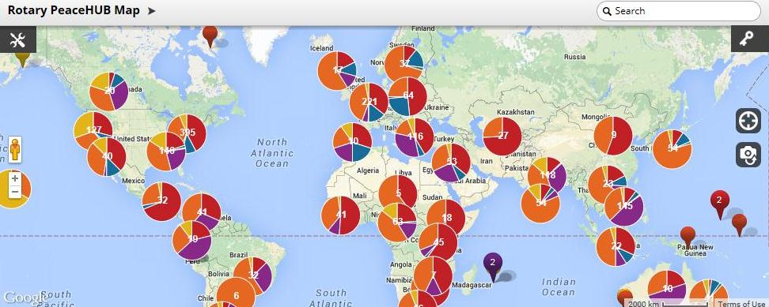
Rotarian Action Group for Peace: PeaceHUB map
Rotarian Action Group for Peace
Mission: Serve as a resource to Rotarians, Rotary clubs,
  and districts by supporting the peace work of Rotarians worldwide.
  www.Rotarianactiongroupforpeace.org
Notes:
The Rotarian Action Group for Peace, a very active group of Rotarians dedicated to supporting the peace work of Rotary and Rotarians worldwide has been making tremendous strides this year. They are a great resource for Rotarians, Clubs, and Districts who are interested in the field of PCPR.
The Rotarian Action Group for Peace has developed an interactive map of Rotary peace resources called the PeaceHub. This tool maps Rotarians working on peace projects, rotary peace fellows, nonprofit organizations working in the field of peace and conflict resolution, and educational institutions offering degrees/trainings in fields of peace and conflict resolution.

Slide 20
Giving to our own charity
The projects we can fund
New DDF each year
It depends…
The Good we can Do
The size of the District Grant
On your support for our charity

Slide 21
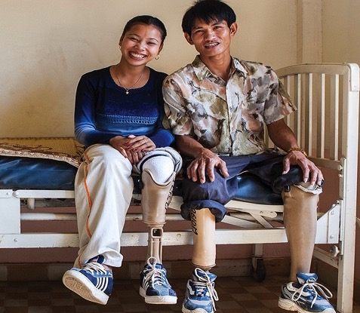
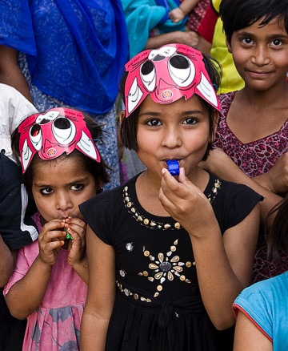
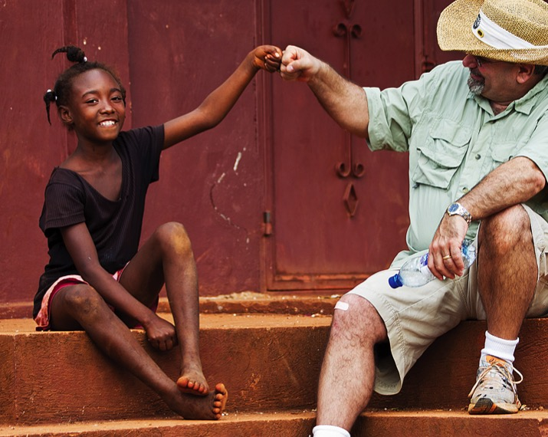
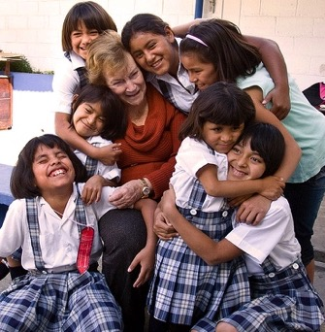
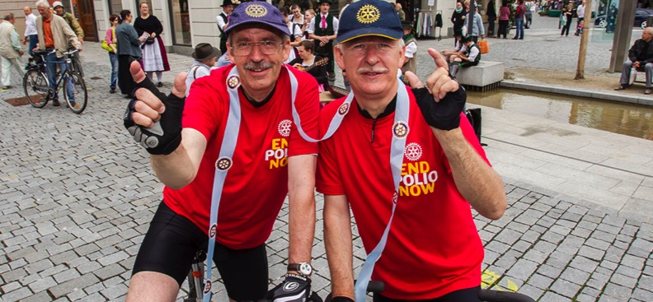
Giving to our own charity
We should not live for ourselves alone, but for the joy in doing good for others
— Arch Klumph, 1929

Slide 22
Further information
Rotary.org for Rotary Club Central reports and the Grants Center.
Updates via Newsletters and on http://foundation.rotary1060.org.uk
Consider donating to Foundation to make funding available for future projects
  Please don’t leave it to the end of the Rotary year ☺

