Slide 1
Our Rotary Foundation
Foundation Grants
Paul Beedham
District Rotary Foundation Chairman 2016-19
Peter Ramage
District Rotary Foundation Chairman 2019-22

Slide 2
Setting the scene
… a brief recap

Slide 3

A tale of four funds
Annual
Fund
Donations
Permanent
Fund
Polio
Fund
Disaster Response Fund
Notes:
The Annual Fund is the ‘default’ when someone donates to The Rotary Foundation. It is the core project fund that will be used in three year’s time to provide the District with its new District Designated Fund (DDF) allocation.
The Permanent Fund usually receives donations from legacy (contributions from wills). It is not spent, with the income from the fund being added to the Annual Fund donations to boost the new DDF allocation.
The Polio Fund is specific to the Polio Eradication work.
The Disaster Relief Fund is new and is explained on the next slide.
3

Slide 4
Global / Local Projects
World
Fund
50% of Every District’s
Annual Fund
District
Designated
Fund
Per District
(x 500+)
Notes:
The Project Funding is split into two. Half from every District makes up the World Fund, with the other half being returned to the control of the District as the new District Designated Fund (DDF).
4

Slide 5
Grants – Funding Projects

Slide 6


Which comes first? Funding or Project

Slide 7
Grant funding
Many grant giving organisations are available
All have specific funding criteria
Design the project to meet the criteria
  Foundation Global Grant projects for ‘Simple Schools’ or ‘Low Cost Shelters’ have very specific requirements
A finalised project will be harder to fund via grants

Slide 8
Rotary Foundation Criteria
Meet the Foundation mission statement
“To enable Rotarians to advance world understanding, goodwill, and peace through the improvement of health, the support of education, and the alleviation of poverty”
More specifically, there are Grant Terms & Conditions that are well documented, but are updated from time to time

Slide 9
District Grant Criteria
Small projects
  Maximum £1,000 funding per Club per project (per year)
  Club has to put in >=50% of project cost
  Has to have Rotarian involvement and / or a publicity opportunity
  Multiple Clubs can pool grant funding
Easiest option is to ‘buy something’ to present
  A unit cost allows the request to be ‘scaled’
  Estimate / Quote with application
  Receipts with report

Slide 10
Global Grant Criteria
Large projects
  Minimum $30,000 project budget
Meet a community need
  Formal needs assessment required
Partner with Club(s) in another country
  >30% of the funding from outside the ‘project country’ (with the exception of Scholarships)
Meet one or more Areas of Focus
  A primary Area of Focus is strongly advised

Slide 11






Areas of Focus
 | Peace and conflict prevention/resolution
 | Disease prevention and treatment
 | Water and sanitation
 | Maternal and child health
 | Basic education and literacy
 | Economic and community development
 | Environment (from 1st 2021)
?

Slide 12
Two stage ‘matching’
Club(s)
Cash contributions from one or more Clubs
District(s)
District Designated Fund contribution
(determined by each District Foundation Committee)
World Fund
100% match for DDF contribution

Slide 13
World Fund Matching
+ 100%
DDF(C+D) Contribution
Project Budget
World Fund
A
C
B
D

Slide 14
Matching – Figures for 70/30 split
So a group of Clubs can run a £24,300 project after raising £8,100
(simply a third of the overall total)

Slide 15
Global Grant Funding Example
Project Budget
World
Fund
Club
DDF

Slide 16
Global Grant Funding Example
Project Budget
World
Fund
DDF

Slide 17
District Grant Specifics

Slide 18
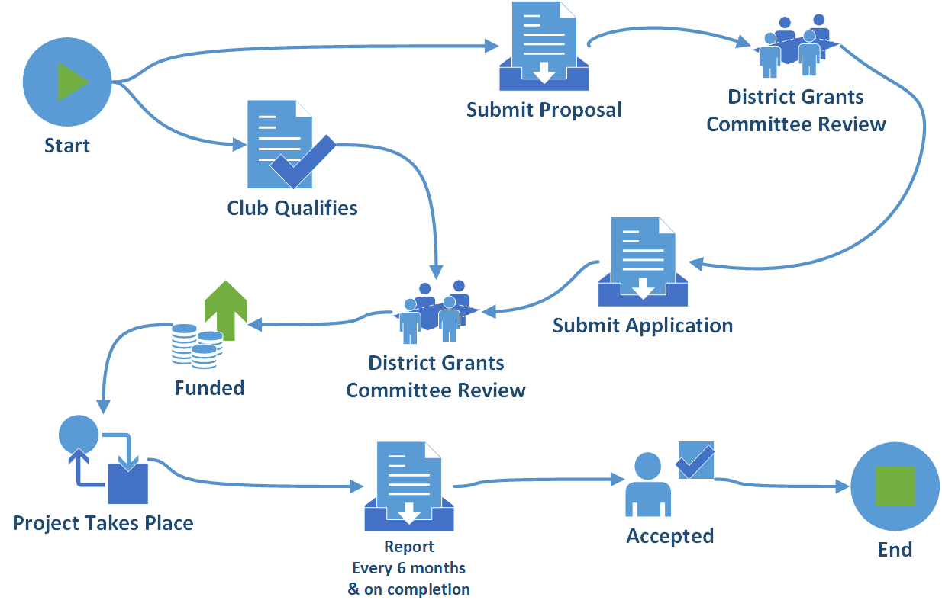
Process
Notes:
18

Slide 19
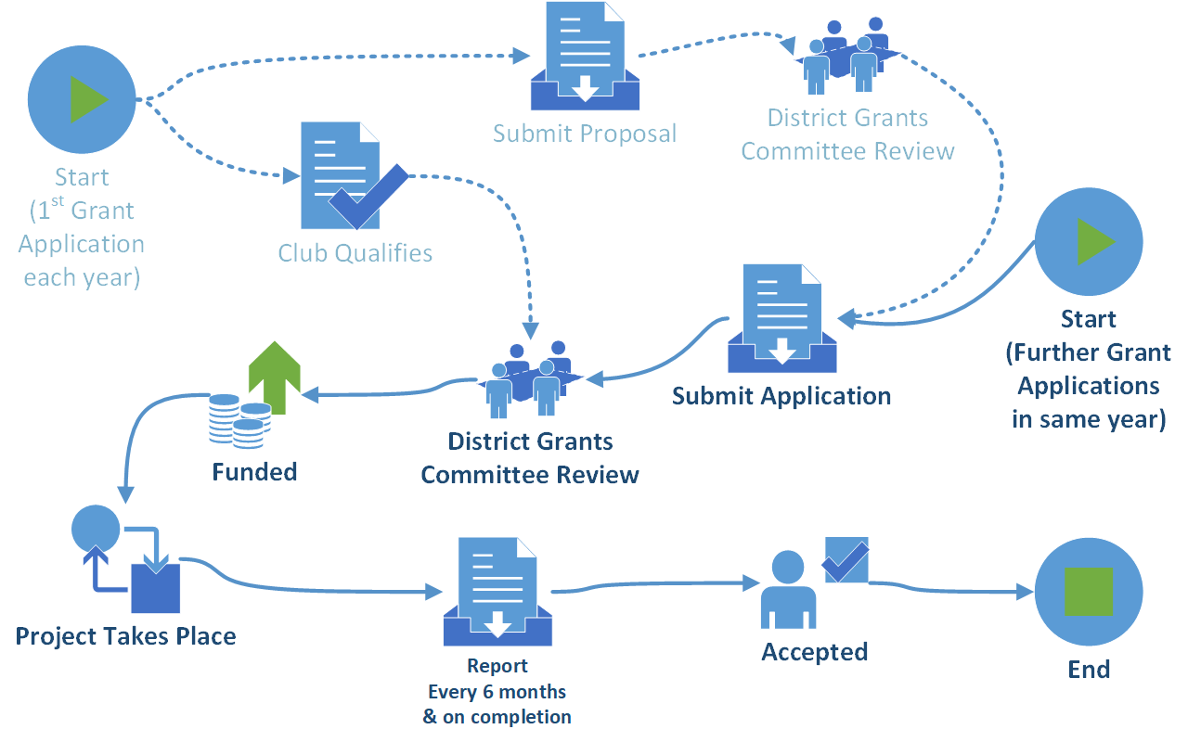
Process (further applications)
Notes:
19

Slide 20
Recommendation
If you have a suitable project idea for a District Grant project
Ideally with no time constraints
Submit it at any time for consideration when funds become available

Slide 21
Further information
Rotary.org for Rotary Club Central reports and the Grants Center.
Updates via Newsletters and on http://foundation.rotary1060.org.uk
Consider donating to Foundation to make funding available for future projects
  Please don’t leave it to the end of the year ☺

